Slide 1
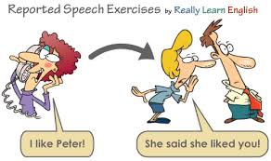
Reported Speech -3
Unit -10 Grade -09 Activity -03
Minuwangoda Zonal Education Office
E- Igenum Piyasa

Slide 2
Mixed Reported Speech 2 (Statements, Questions, Requests and Orders)
Change the direct speech into reported speech. Choose the past simple of ‘ask’, ‘say’
or ‘tell’:
1. “Come quickly!”
She ______________________________________________________________
2. “Did you arrive before seven?”
She ______________________________________________________________
3. “How was your holiday?”
She ______________________________________________________________
4. “I would have visited the hospital, if I had known you were sick”
She ______________________________________________________________
5. “Don't touch!”
She ______________________________________________________________
6. “Do you usually cook at home?”
She ______________________________________________________________

Slide 3
7. “They had never been to Scotland until last year”
She ______________________________________________________________
8. “Make sure you arrive early!”
She ______________________________________________________________
9. “I should have studied harder for the exam”
She ______________________________________________________________
10. “Would you mind telling me how to get to the art gallery, please?”
She ______________________________________________________________
11. “Please don’t forget my book”
She ______________________________________________________________
12. “Make sure you arrive at six!”
She ______________________________________________________________
13. “Remember to study hard!”
She ______________________________________________________________

Slide 4
14. “Where do you want to eat tonight?”
She ______________________________________________________________
15. “I usually drink coffee in the mornings”
She ______________________________________________________________
16. “Do you like studying English?”
She ______________________________________________________________
17. “I’ll come and help you on Saturday”
She ______________________________________________________________
18. “Please buy some bread on your way home”
She ______________________________________________________________
19. “Please give this to John”
She ______________________________________________________________
20. “Could you give me the glass on the table, please?”
She ______________________________________________________________

