Slide 1

GRADE -08
COMPETANCY -06
COMPETANCY LEVEL -6.1
MINUWANGODA ZONAL EDUCATION OFFICE.
E-IGENUM PIYASA

Slide 2
What is passive voice?
We use passive voice when the doer(subject) is unimportant.
Rice is cooked.
We use passive voice mostly in formal texts.
If we want to say who performs the action in passive we use “by”
Rice is cooked by mother.
Passive voice does not change the contextual meaning.

Slide 3
Subject Verb Object
I play football
(Active)
Football is played by me.
(Passive)
Object
Auxiliary verb
verb
subject

Slide 4
Passive voice (Simple Present)
(am/is/are/ +verb past participle )
Mother cooks rice in the kitchen.
Rice is cooked by mother in the kitchen.
O
V
S

Slide 5
Steps
1.Analyze the sentence into Subject ,verb ,and object.
2.Object is taken to the front.
3.Use a suitable auxiliary that suits the object.(am/is/are)
4.Main verb is transformed into past participle.
(Note :In all passive voice sentences verbs are written in past participle).
5.Subject is added to the back with by.
6.Finally adds the rest of the sentence.

Slide 6
Subject change
Subject | Passive
He | by him
She | by her
It | by it
I | by me
We | by us
You | by you
They | by them
Raja | by Raja

Slide 7
More Examples
1.Mayuri makes beautiful kites.
Beautiful kites are made by Mayuri.
2. She helps me to do my home work.
I am helped by her to do my home work.

Slide 8
3.Sagara rides his bicycle in the evening.
His bicycle is ridden by Sagara in the evening.

Slide 9
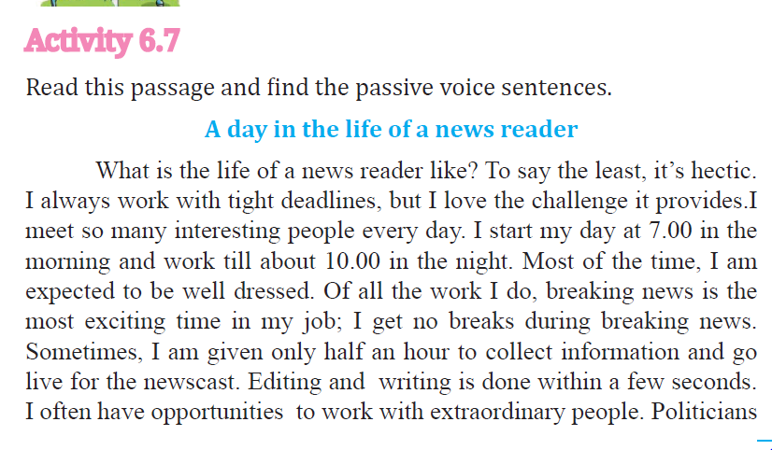
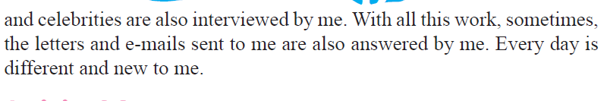

Slide 10
Fill in the blanks to complete the sentences. Use Present Passive voice.(am/is/are + v.p.p)
1.Class ……………………by the students.(arrange)
2.Flowers…………………..by Kamani (bring)
3. Floor…………………..by Ayami. (sweep)
4. I ………………………by Zeena. (help)
5. Cob webs………………by the boys. (clean)
6.Register………………by the monitor. (bring)

Slide 11
7. Desks …………………..by the girls.(arrange)
8. Waste………………..into the bins.(put)
9.Lessons…………………….by the teachers. (teach)
10.Cupboards ………………….by Chathura. (dust)

Slide 12
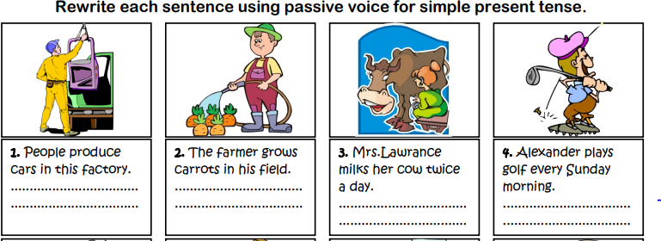

Slide 13
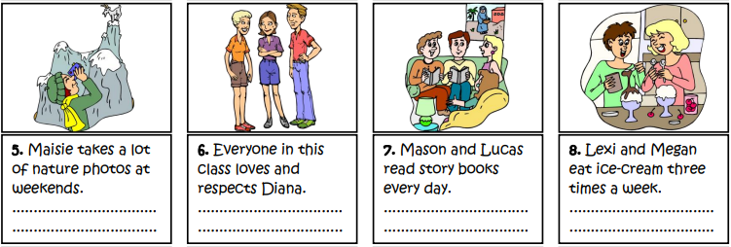

Slide 14
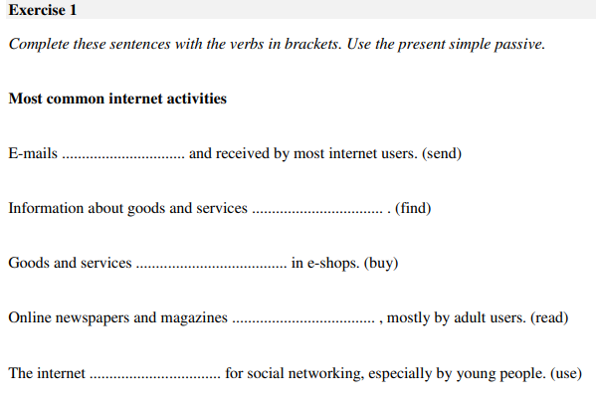

Slide 15
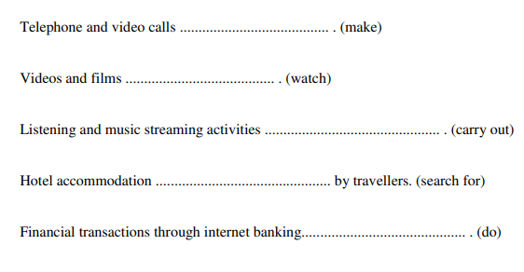

Slide 16
Thank you!

