Slide 1
Comparing things
Use of Comparative and superlative adjectives
Grade 8
Unit- 05 Activity -5.5
Competency - 08 Competency Level - 8.3
Minuwangoda Zonal Education Office
E Igenum Piyasa

Slide 2
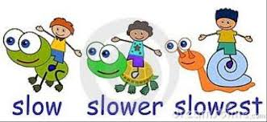
Look at the following example.
Slow is an adjective.We have added -er and -est suffixes to form comparative and superlative adjectives.
We use comparatives and superlatives to compare things.

Slide 3

Comparing things.
Example -02
A is a short girl
B is shorter than A,
C is the shortest girl.
A B C

Slide 4
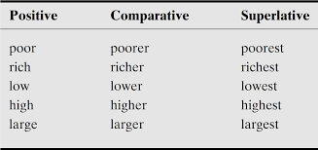
Grammar rules for comparative and superlatives
1. Adding –er and -est

Slide 5
2.Adding - ier and -iest
Positive | Comparative | Superlative
happy | happier | happiest
funny | funnier | funniest
pretty | prettier | prettiest
easy | easier | easiest
dirty | dirtier | dirtiest
noisy | noisier | noisiest
heavy | heavier | heaviest

Slide 6
3.Doubling the last letter (when one syllable word ends with a consonant and it is followed by a vowel
Positive | Comparative | Superlative
big | bigger | biggest
slim | slimmer | slimmest
thin | thinner | thinnest
fat | fatter | fattest
wet | wetter | wettest
hot | hotter | hottest

Slide 7
4.We add “more” and “most” when the adjective has more than 6 letters.
Positive | Comparative | Superlative
powerful | more powerful | most powerful
careful | more careful | most careful
expensive | more expensive | most expensive
intelligent | more intelligent | most intelligent
interesting | more interesting | most interesting
dangerous | more dangerous | most dangerous
enjoyable | more enjoyable | most enjoyable

Slide 8
5.Some adjectives have irregular comparatives and superlatives.
Positive | Comparative | Superlative
good | better | best
bad | worse | worst
Far | further | furthest
old | elder | eldest
little | less | least
many | more | most
much | more | most

Slide 9
Use always “than” in comparative forms slower than faster than dirtier than more beautiful than
Use always “the” before superlatives the slowest the fastest the dirtiest the most beautiful

Slide 10
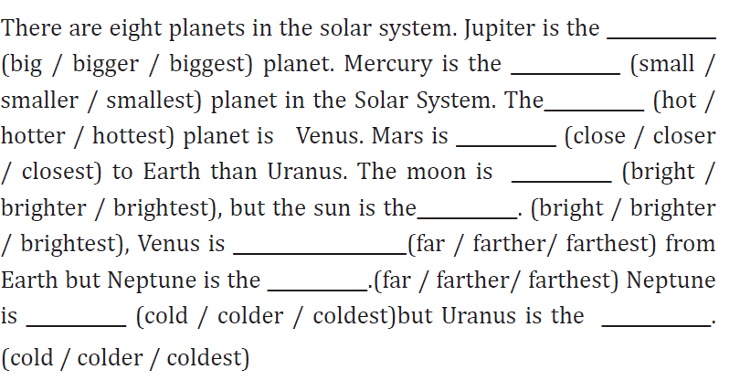
Activity 5.6

Slide 11
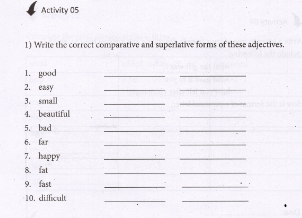
Work book

Slide 12
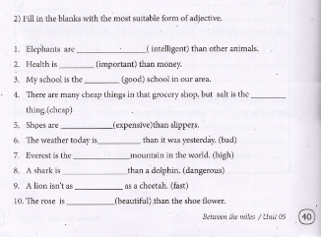
Work book
Work book

Slide 13
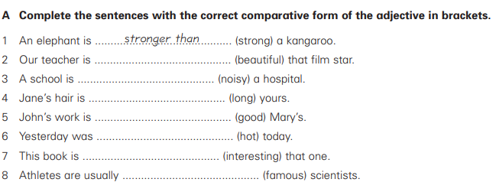
Additional exercise

Slide 14
Thank you

