Slide 1
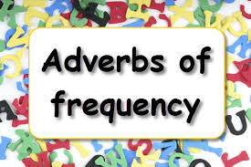
Adverbs of frequency
Grade -08
Unit -09 Activity -9.2
Minuwangoda Zonal Education Office
E -Igenum Piyasa

Slide 2
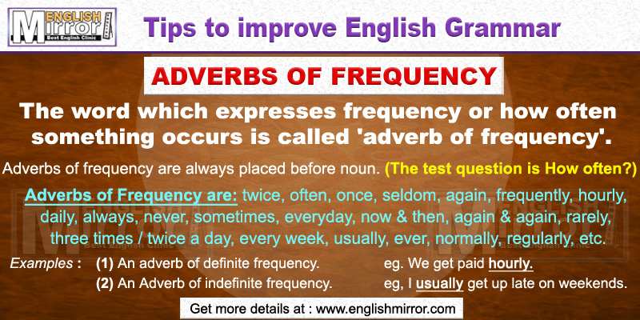
What is an adverbs of frequency?

Slide 3
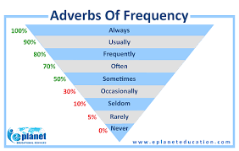

Slide 4
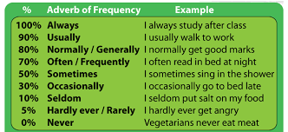

Slide 5
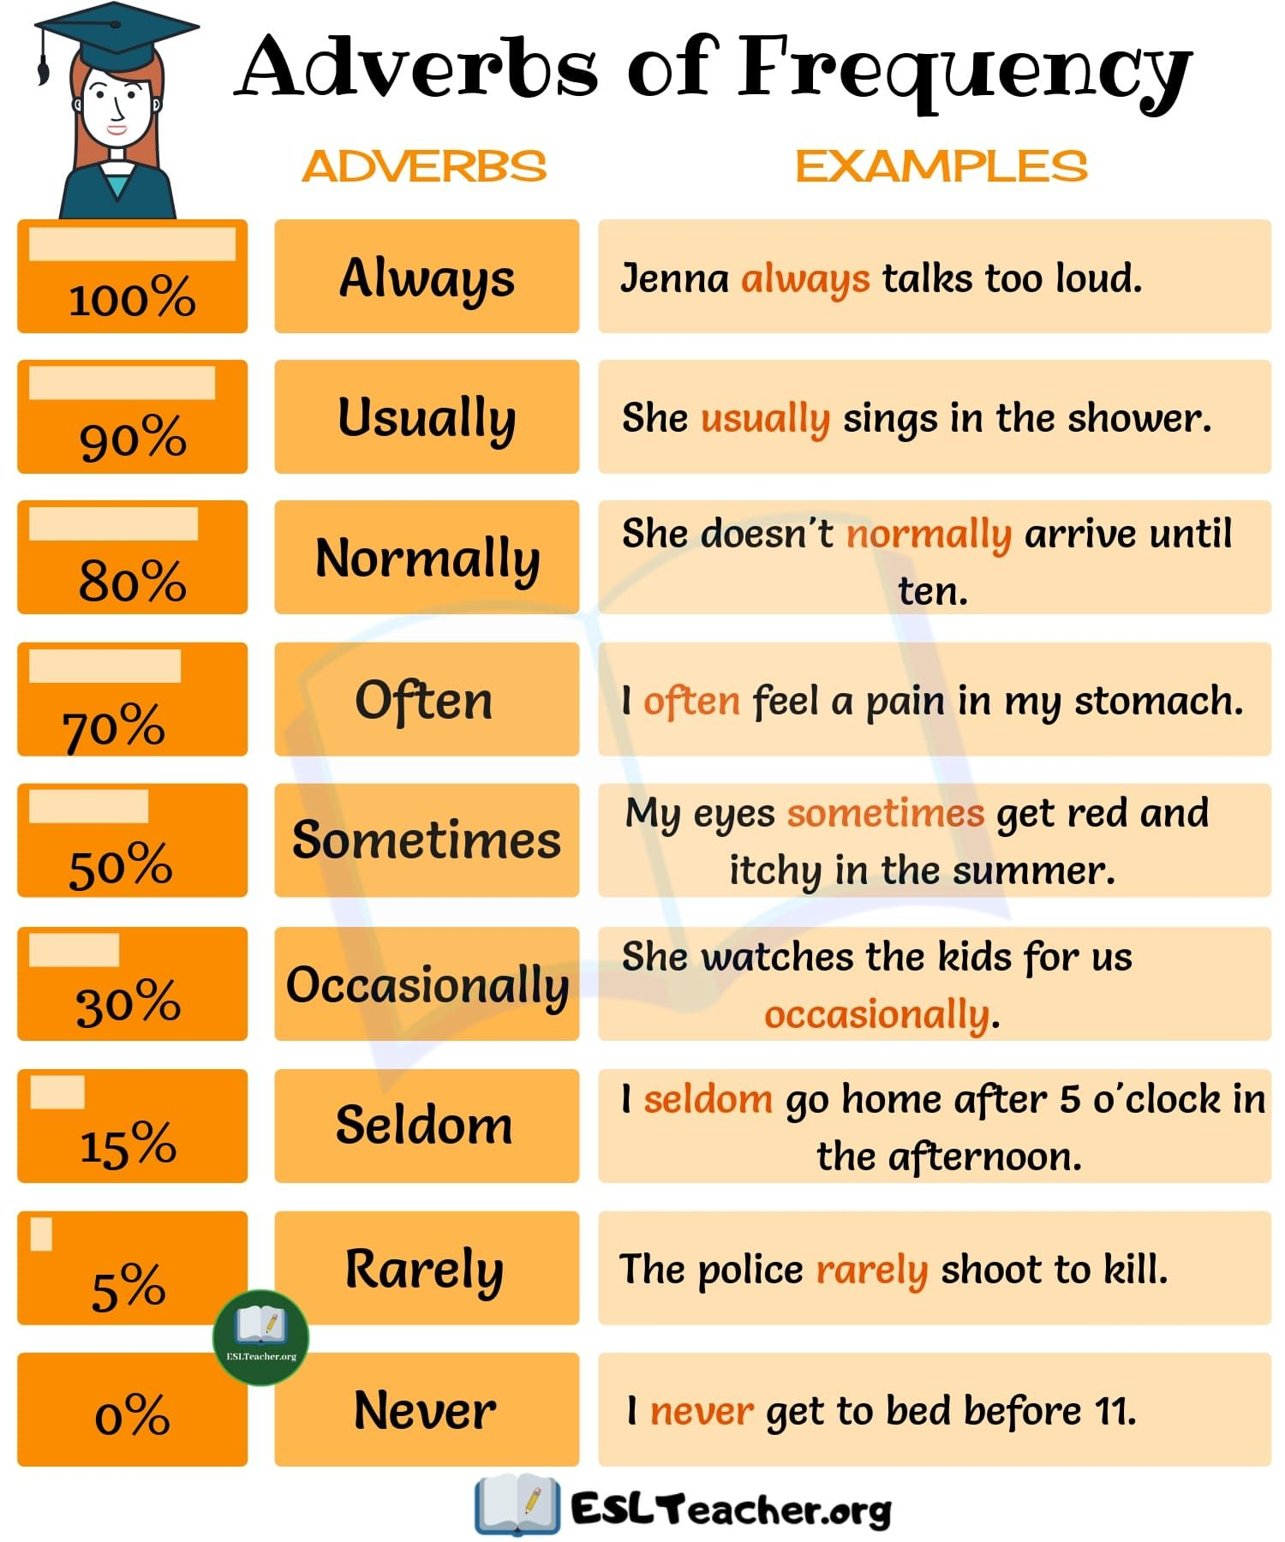

Slide 6
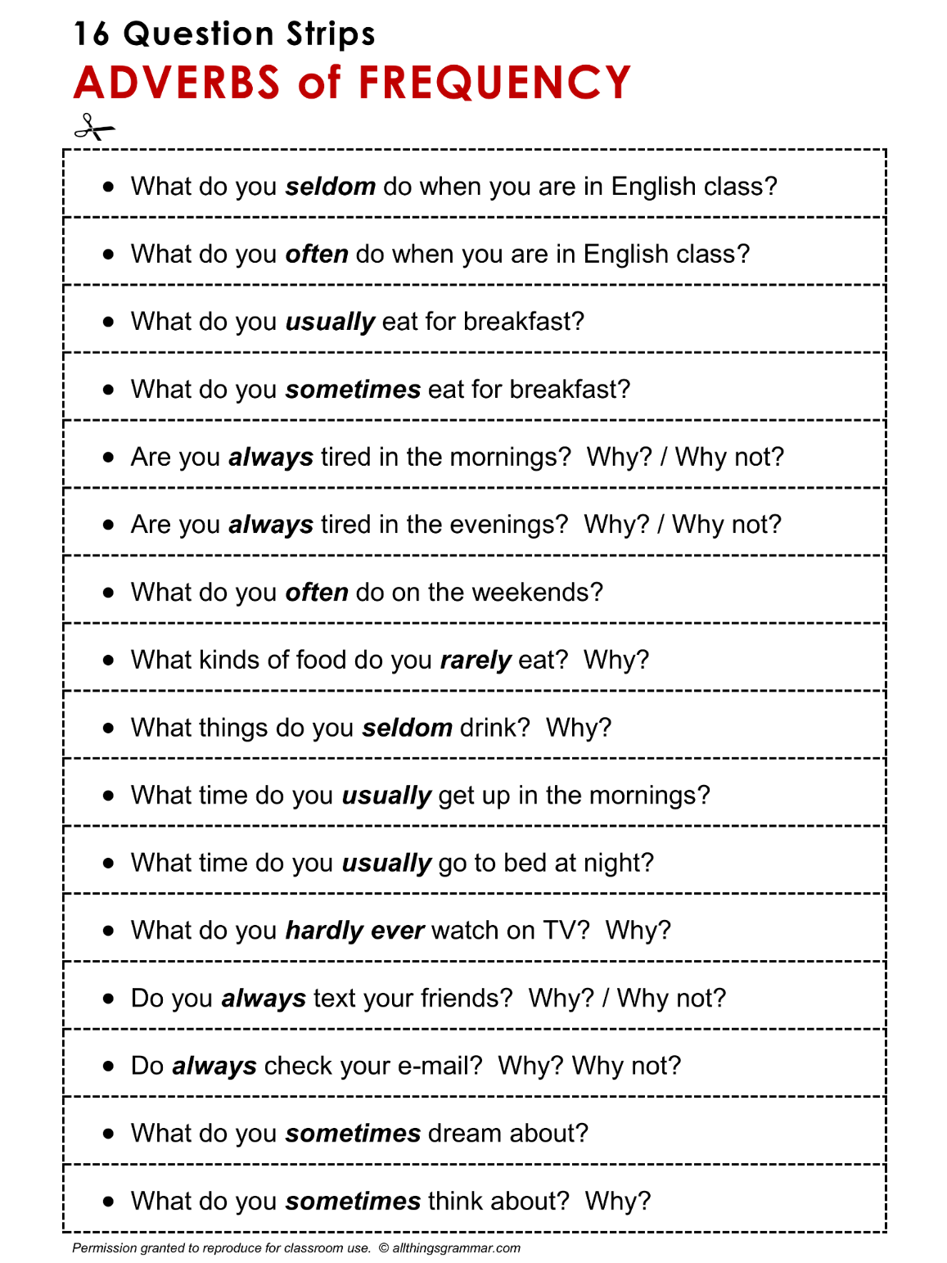

Slide 7
Fill in the blanks below with the best adverbs of frequency (some sentences may have more than one answer).
1. My brother is never sad. He’s _______________ happy.
2. I was late for work only one time last year. I’m _______________ late.
3. Mary failed only one test in high school. She _______________ passed her tests.
4. I always remember to do my homework. I _______________ forget to do it.
5. Steven seldom goes to a cinema. He _______________ sees movies.
6. Judy saw a doctor for the first time in three years. She _______________ gets sick.
7. I get up at five o’clock seven days a week. I _______________ get up early.
8. It’s always hot and sunny where I live. That’s why I _______________ see snow.
9. A: Do you ever drink coffee? B: Yes, but only _______________, not often. Just a few times a week.
10. My sister almost never eats burgers and fries. She _______________ eats healthy foods.
11. I _______________ take a bus to class, maybe three or four days a week.
12. A: Do you ever watch action movies? B: No, never. Well, I watched an action movie a few years ago, so I guess should say ______________

Slide 8
Put the words in the correct order to make sentences, as in the example.
play /often / on / Sundays / they / football
They often play football on Sundays.
late / is / she / sometimes
early / up / sister / never / Sundays / on / gets / my
usually / he / goes / to / on / Fridays / the / cinema
go / you / restaurant / often / a / do / how / to / ?
she / the / beach / to / always / goes / in / the / summer
sometimes / her / does / she / Fridays / on / shopping
go / we / twice / month / the / theatre / to / a
never / in / is / the / at / mornings / Peter / home
he / work / rides / bike / to / his / often
home / they / get / six o’clock / usually / at
every / homework / students / their / good / do / day
you / out / how / in / do / evenings / often / go / the / ?

