Slide 1
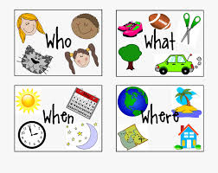
“Wh” question words
Grade - 04
Minuwangoda Zonal Education Office.
E –Igenum Piyasa

Slide 2
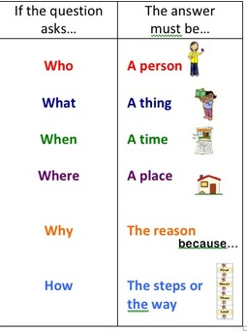

Slide 3
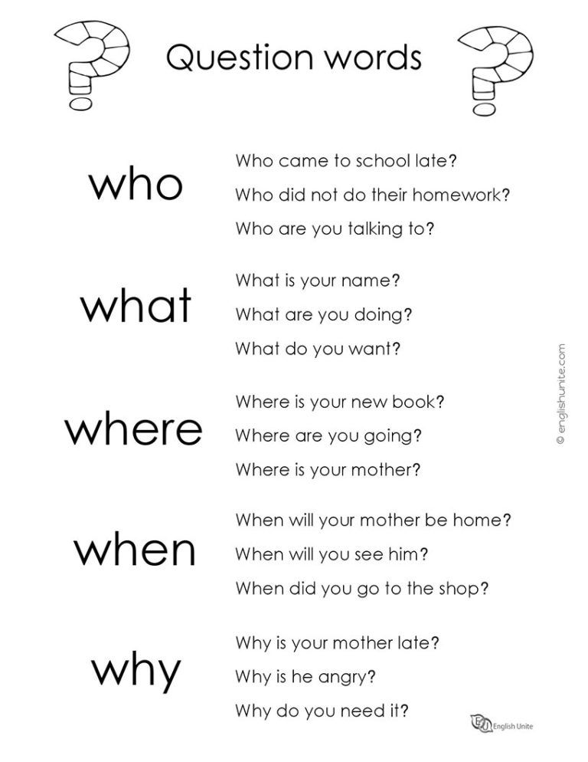

Slide 4
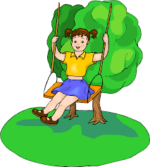
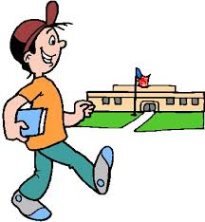
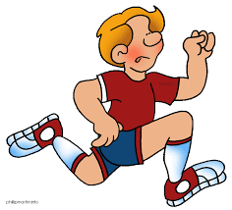

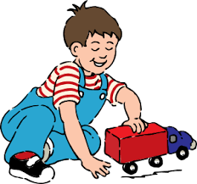

Who
1.Who is walking?
Jason is walking.
2.Who is running?
3.Who is playing?
4.Who is swinging?
5.Who is swimming?
6.Who are talking?
Ann | Jason
Tony | Freeda
Mike | Liz and Yullie

Slide 5
What
1.What is Ann doing?
Ann is swinging.
2.What is Jason doing?
3. What is Tony doing?
4.What is Freeda doing?
5.What is Mike doing?
6.What are Liz and Yullie doing?
Ann | Jason
Tony | Freeda
Mike | Liz and Yullie

Slide 6
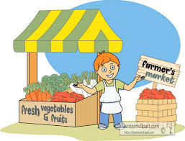


Where
Tom | Jason
Children | doctor
1.Where is Tom?
Tom is at farmer’s market.
2.Where is Jason?
3.Where are the children?
4.Where is the doctor?
at hospital at farmer’s market at school in the bus

Slide 7
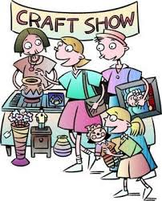
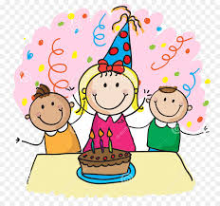
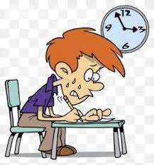

When
1.When is the craft show?
The craft show is on Sunday.
2.When is Meenu’s birthday?
3.When is Sam’s exam?
4.When is the book fair?
On Sunday | On 25th
At 3.00 p.m | On 10th December

Slide 8
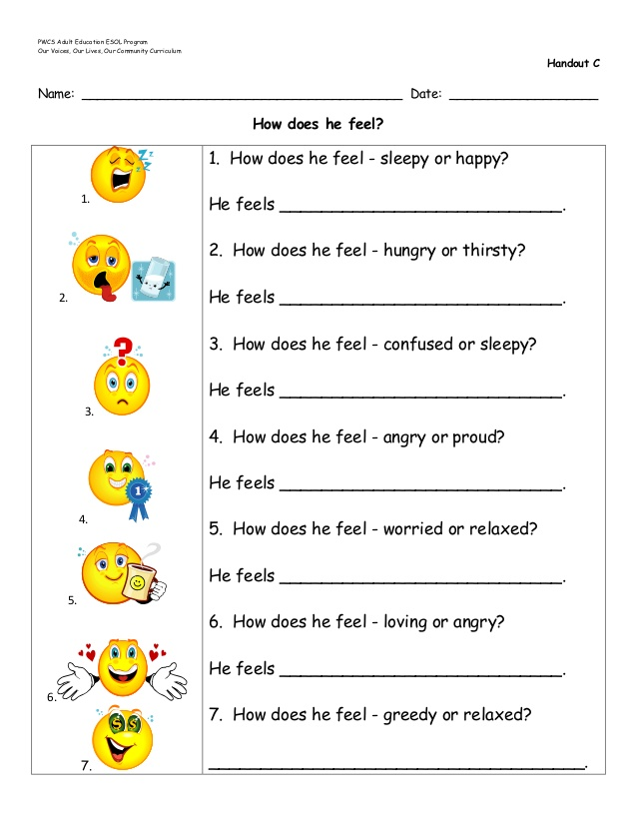
How

Slide 9
Let’s write answers.
1.What is your name?
My name is………………………………………………………………………………………….
2.Where do you live?
I live at………………………………………………………………………………………………..
3.What class are you in?
I am in………………………………………………………………………………………………..
4.How old are you?
I am……………………………………………………………………………………………………….
5.Who is your class teacher?
She is Mrs. ..……………………………………………………………………………………

Slide 10
6.Who is your mother?
She is Mrs. ……………………………………………..................................................
7.How do you go to school?
I go by…………………………………………………………………………………………………
8.What is your favourite subject?
My favourite subject is…………………………………………………………..............
9.When do you watch cartoons?
I watch cartoons in the………………………………………………………………………
10.What is your pet?
My pet is a…………………………………………………………………………………………
10.When is your birthday?
My birthday is in………………………………………………………………………………..

Slide 11
