Slide 1



ports

Slide 2








03
01
02
Questions
on
ports
04
05

Slide 3


Question Number 01
h;=remqjrej iy uQislh ioyd ''''''''''''''''''''''''''''''''''' flfjks (Port) fyda''''''''''''''''''''''''''''''''''' flfjks Ndú; l< yels h'
A .
B.
PS2 flfjks USB flfjks
VGA flfjks USB flfjks
C.
D.
DVI flfjks VGA flfjks
Parallel flfjks USB flfjks

Slide 4
Question Number 02
mß.Klhg mß.Kl ;srh ^Monitor/ ikao¾Ylhla ) iïnkaO l< fkdyels flfjksh jkafka"
A .
B.
HDMI flfjksh
DVI flfjksh
C.
D.
VGA flfjksh
USB flfjksh

Slide 5
Question Number 03
RJ45 iïnkaOlh iys; /yek iïnkaO lrkq ,nkafka '''''''''''''''''''''''''''''''''''''''''''flfjksh g h'
A.
B.
HDMI flfjksh
DVI flfjksh
C.
D .
VGA flfjksh
RJ45 flfjksh

Slide 6
Question Number 04
mß.Klhg rEmjdyskshla (TV) iïnkaO lrkafka kï jvd;a iqÿiq flfjksh jkafka"
A .
B.
HDMI flfjksh
eSata flfjksh
C.
D.
DVIflfjksh
USB flfjksh

Slide 7
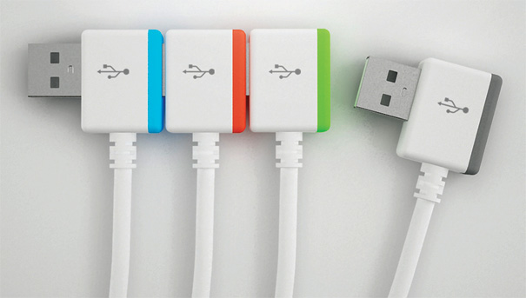
Question Number 05
my; oelafjk flfjksh jkafka"
A .
B.
HDMI flfjksh
VGA flfjksh
C.
D.
DVIflfjksh
USB flfjksh

Slide 8




Correct Answer
Quiz

Slide 9






Wrong Answer
Quiz

Slide 10
පසු වැඩ
mrs.Kl flfjks kus කර, úiA;r lrkAk

