Slide 1
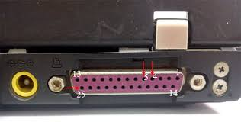
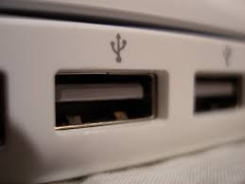
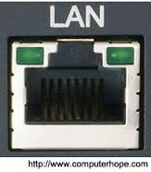
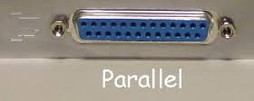
සාරාංශය

Slide 2
flfjks (ports)

Slide 3
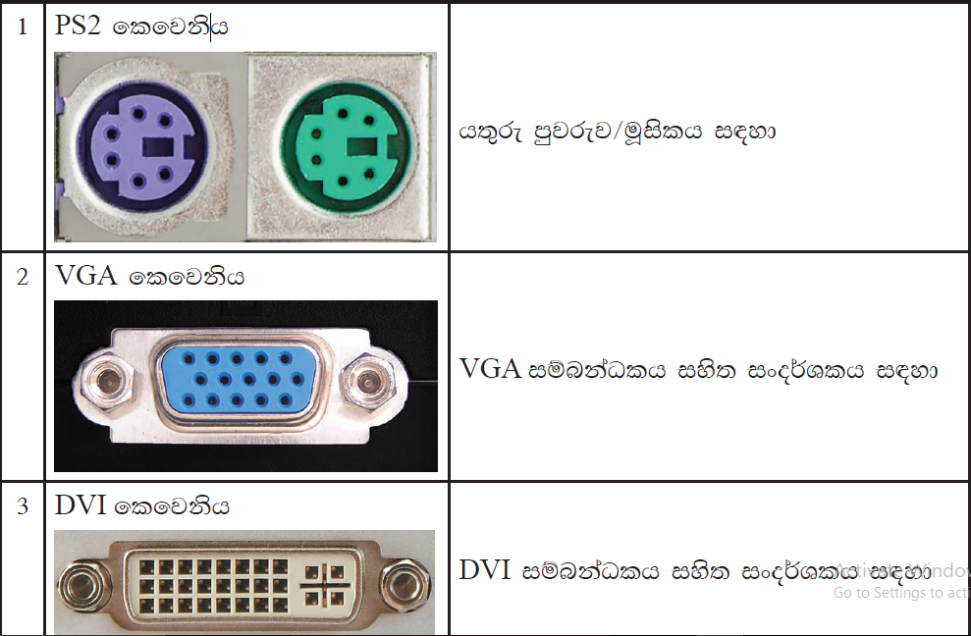

Slide 4
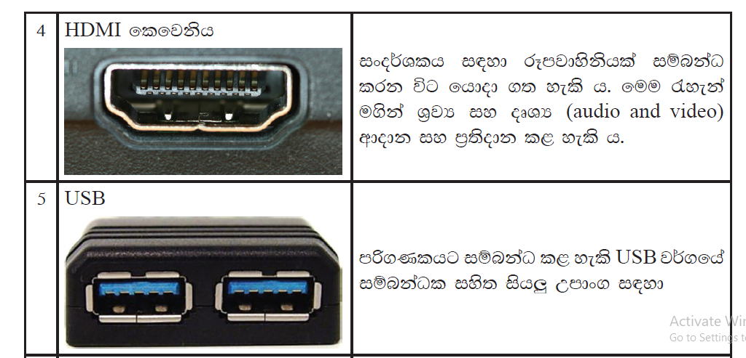

Slide 5
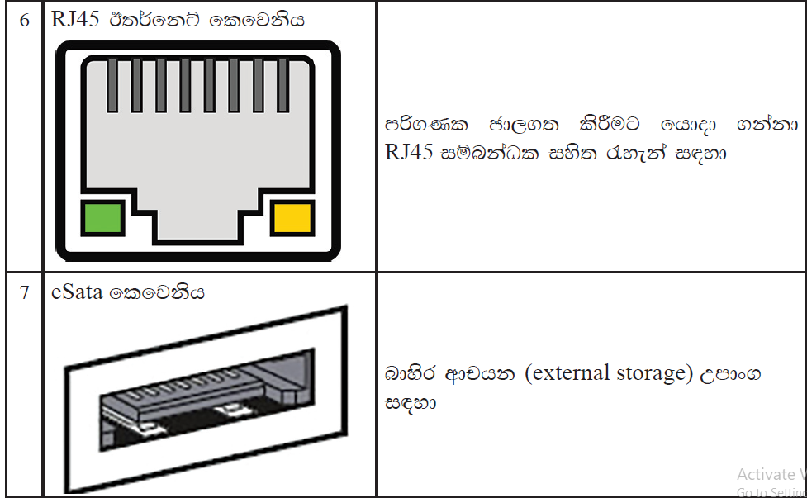

Slide 6
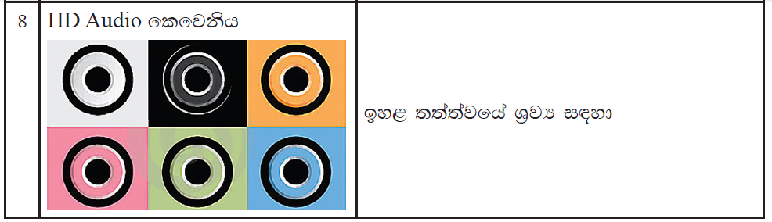

Slide 7
by; oelafjk flfjks j,g wu;rj fïi mß.Klj, fuka u Wl=¿ mß.Klj," geí iy cx.u ÿrl;kj, we;s flfjks lsysmhla my; rEmh olajd we;'

Slide 8
