Slide 1
mrs.Kl flfjks

Slide 2
mrs.Kl flfjks
mß.Klh iy mß.Kl Wmdx. fyda fjk;a mß.Kl tlsfkl iïnkaO lrk w;=re uqyqK;a flfjks f,i oelaúh yels h'
mß.Klhl flfjks msysgd we;af;a mß.Klfha msgqmiska fyda bÈßmiska h'

Slide 3
mrs.Kl flfjks
flfjks y÷kd .ekSu i|yd ixfla; olajd we;'
ish¨u flfjks ujq mqjrejg ^motherboard& iïnkaO lr we;'

Slide 4
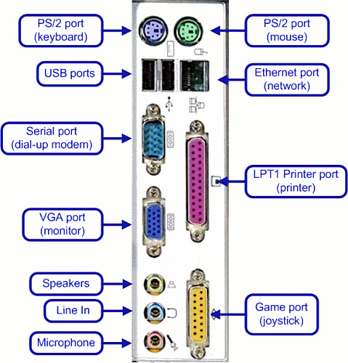

Slide 5
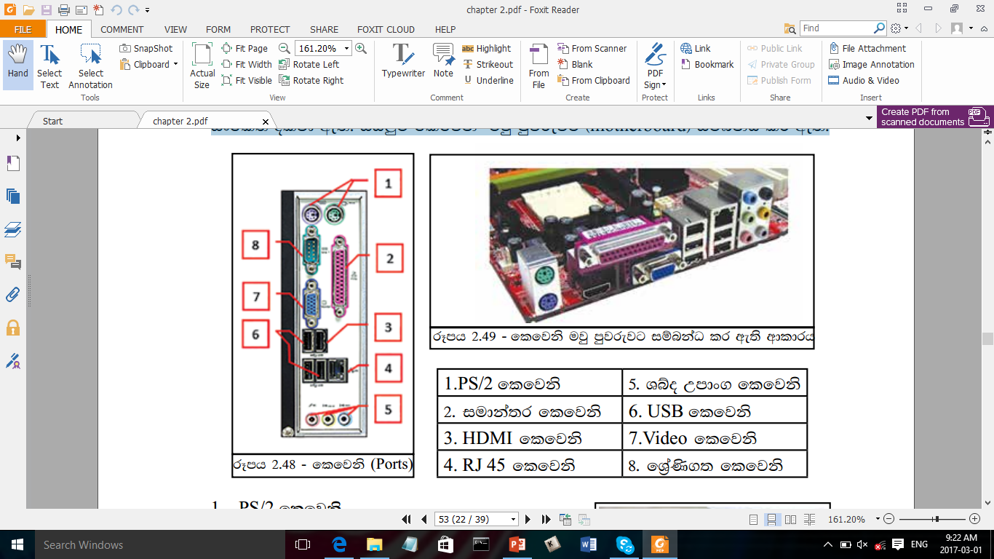

Slide 6
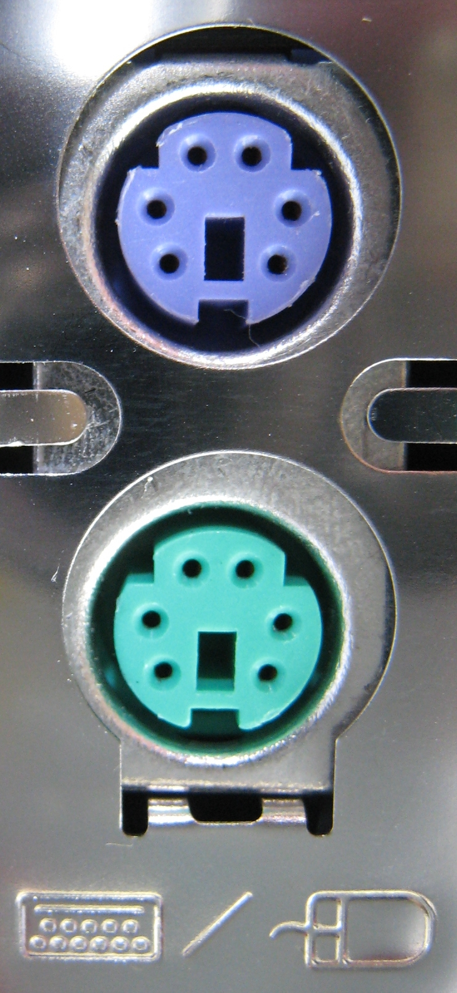
PS/2 flfjks
h;=re mqjrej iy uQislh mß.Kl moaO;shg iïnkaO lsÍu i|yd fhdod .efka'
oï - h;=re mqjrej
fld< -uQislh

Slide 7
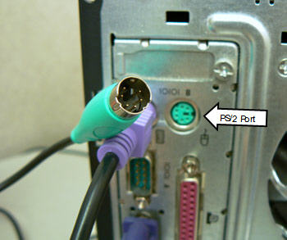
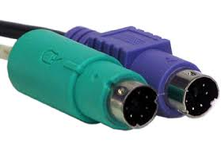

Slide 8
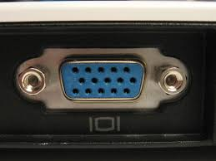
VGA port
mß.Kl ;srh (ixo¾Ylh) mß.Kl moaO;shg iïnkaO lsÍu i|yd fhdod .efka'
fuh újr 15 lska iukaú; h'

Slide 9
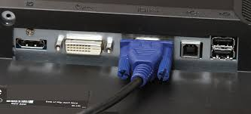
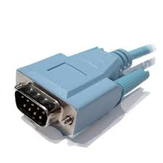

Slide 10
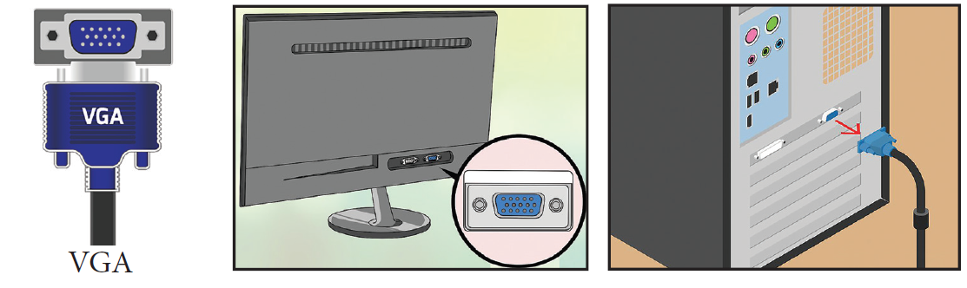

Slide 11
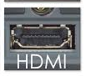
HDMI flfjksh
mß.Kl ;srh ^Monitor& (ixo¾Ylh)
nyqudOH m%lafIamlh
äðg,a rEmjdyskS hka;%
äðg,a Yío jdyskS hka;%
iïnkaO lsÍu i|yd fhdod .kq ,nhs'

Slide 12
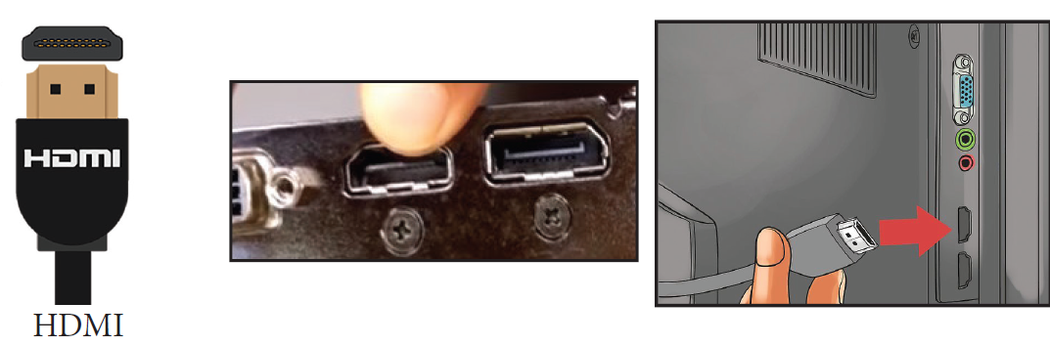

Slide 13
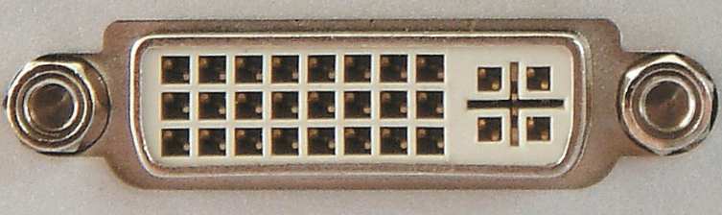
DVI flfjksh
DVI iïnkaOlh iys; mß.Kl ;srh (ixo¾Ylh) i|yd

Slide 14
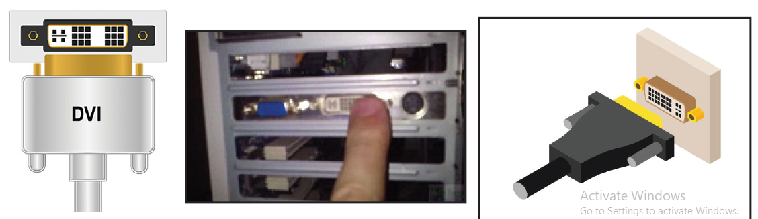

Slide 15
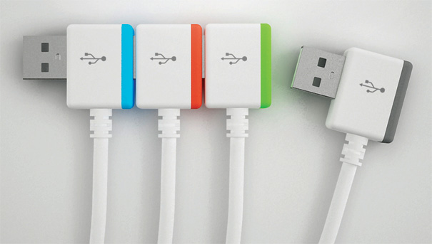
USB Ports
j¾;udkfha § wdodk iy m%;sodk Wmdx. fndfydauhla u mß.Klhg iïnkaO lrkq
,nkafka USB flfjksh u.ska h'

Slide 16
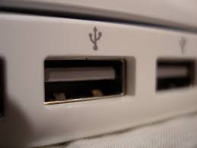
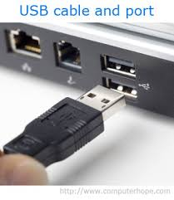

Slide 17
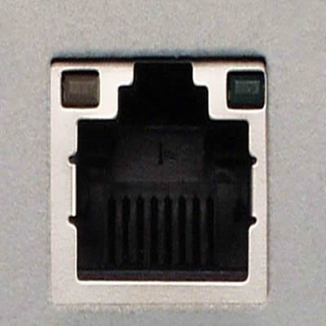
RJ 45 flfjksh
mß.Kl cd,hl we;s mß.Kl" cd, rjqgrh ^Network Router& cd, iaúphg ^Network Switch& iïnkaO lrkq ,nhs'

Slide 18
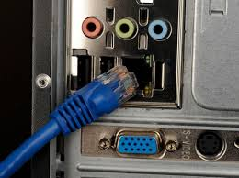
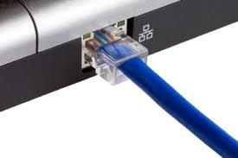

Slide 19
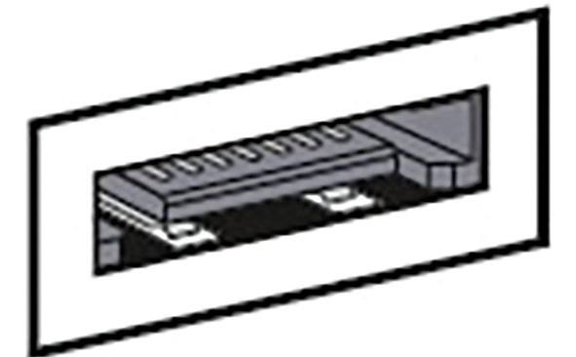
eSata flfjksh
ndysr wdphk (externalstorage) Wmdx. i|yd

Slide 20
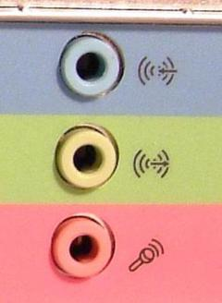
Yío Wmdx. flfjks (Audio Port/ Jack)
uhsl%f*dak" iamSlr iy bia nkqj(Head Phone) jeks Y%jH udOH mß.Kl moaO;shg iïnkaO lsÍu i|yd
ks,a mdg - Yío wdodkh (Line In)
fld< mdg- iamSlr Yío m%;sodkh (Line Out - Head Phone)
frdai mdg - uhsl%f*daka (Microphone)

Slide 21
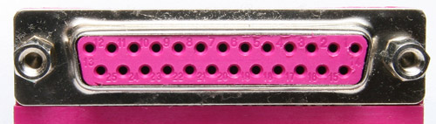
iudka;r flfjksh (Parallel Port)
uqøK hka;%h mß.Kl moaO;shg iïnkaO lsÍu i|yd iudka;r flfjksh Ndú; fõ
fuh újr 25 lska iukaú; h'
tfy;akùk uqølj, we;af;a USB iïnkaOl /yeka
ksid kùk mß.Klj,ska fuu flfjksh bj;alr we;'

Slide 22
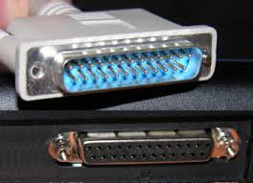

Slide 23
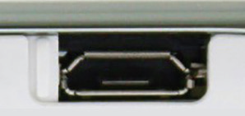
Micro USB flfjksh
cx.u ¥rl:k
MP 3 Odjl
photo printer
äðg,a leurd
jeks iqyqre Wmdx. iïnkaO lsÍug fhdod.efka'

Slide 24
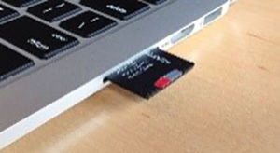
SD card reader
SD card lshùu i|yd Ndú; flf¾
Wl=¿mß.Kl geí jeks WmlrKj, olakg ,efí'

