Slide 1
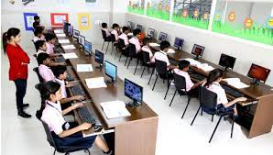
02' mß.Kl úoHd.drh wdrlaIs;j Ndú;h
tÉ'mS' ikaOHd Ysfrdañ

Slide 2
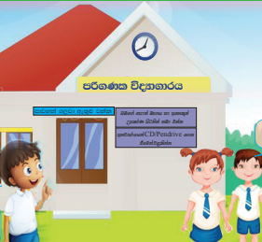
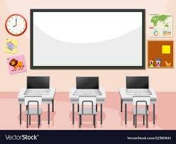
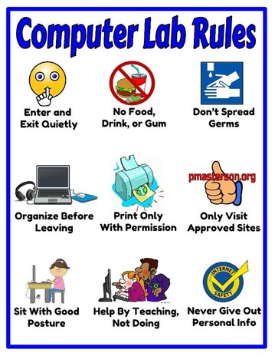
mß.Kl úoHd.drh ksjerÈj mßyrKh lsÍu
Tnf.a wdrlaIdj i`oyd wkq.ukh l< yels ls%hdud¾.
Wmdx. j, wdrlaIdj i`oyd wkq.ukh l< yels ls%hdud¾.

Slide 3
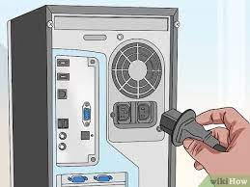
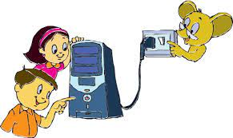
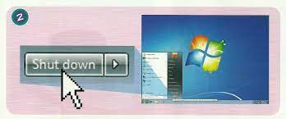
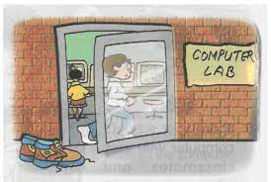
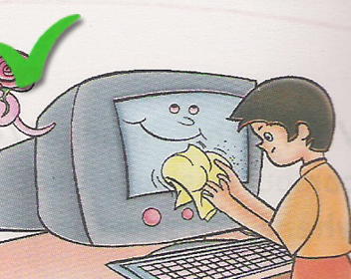
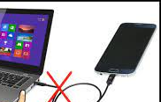
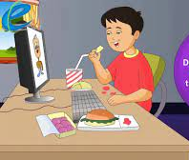
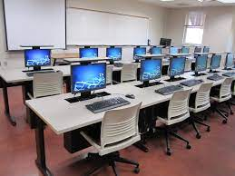
Wmdx. j, wdrlaIdj i`oyd wkq.ukh l< yels ls%hdud¾.
Ndú;fhka miq ish¨ WmlrK ksis mßÈ ls%hd úrys; l< hq;=h
ksjerÈ Wmfoia fkdue;sj úÿ,sn,h iemhSu fkdl< hq;=h
úoHd.drh iy WmlrK ÿyqú,af,ka f;drj msßisÿj ;nd .; hq;=h
mdjyka .,jd úoHd.drhg we;=`M úh hq;=h
ndysr wdphk Wmdx. iïnkaO fkdl< hq;=h
úoHd.drh ;=<g wdydr /f.k tAfuka je<lsh hq;=h
Ndú;d l< WmlrK ksis mßÈ wod< ia:dk j, ;eìh hq;=h

Slide 4
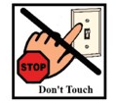
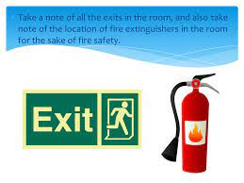
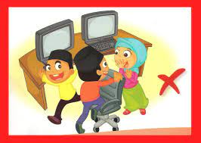
Tnf.a wdrlaIdj i`oyd wkq.ukh l< yels ls%hdud¾.
/yeka iy flfjks jeks úÿ,shg iïnkaO jk Wmdx. we,a,Sfï§
.sks ksjk WmlrK we;akï ta ms<sn`o oekqj;a úh hq;=h'
mß.Kl úoHd.drh ;=< ÿj mek fi,a,ï lsÍfuka je<lsh hq;=h'
úoHd.drfhka msgjk fodrgq ms<sn`o oekqj;a úh hq;=h'

Slide 5
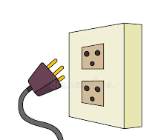
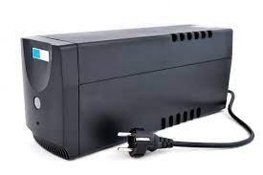
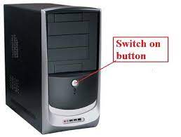
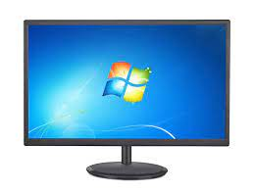
mß.Klh ls%hd;aul lrk wdldrh
1
ì;a;sfha mß.Klh iïnkaO lr we;s iaúÉph ls%hd;aul lrkak'
2
mß.Klh ks¾ndOl cj iemhqulg iïnkaO lr ;sfí kï th mK .ekaúh hq;=h'
Un-Interrupted Power Supply (UPS)
3
moaO;s tallh (System Unit) mK .ekaúh hq;=h'
4
mß.Kl ixo¾Ylh (Monitor) mK .ekaúh hq;=h'

Slide 6
mß.Klh ls%hdúrys; lrk wdldrh
lsishï jevigykla újD; lr ;snqKd kï thska bj;a úh hq;=h'
jid oeófï (Shut down) úOdkh f;dard la,sla (Click) l< hq;=h'
ixo¾Ylh l`M meye .ekafjk ;=re ys`§fuka miqj tys On/ Offfnd;a;u u.ska ls%hd úrys; l< hq;=h'
ks¾ndOl cj iemhqu;a úÿ,s n,h iemhQ iaúÉph;a ls%hd úrys; l< hq;=h'

Slide 7
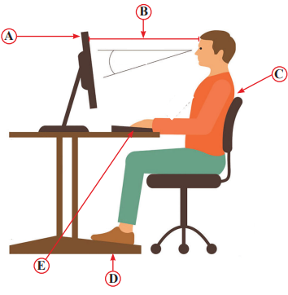
mß.Klh Ndú;fha § wkq.ukh l< hq;= ksjerÈ bßhõ iy ksjerÈ bßhõ mj;ajd fkd.;a úg we;s jk frda.dndO
iEuúgu mß.Kl ;srh ;u weia uÜgug fyda Bg uola my<ska ;nd .; hq;=h'
A
wei;a mß.Kl ;srh;a w;r ÿr w`.,a 18-28 w;r m%udKhl ;nd .; hq;=h'
B
wefia fõokdj
ks;r l`ÿ`M .e,Su
weia fmkSfï ÿ¾j,;d
C
fldkao fl<ska ;nd mqgq wekaog fyd`Èka fya;a;= ù jdä úh hq;=h'
fldkafoa fõokd
D
mdo fmdf<djg ,ïnlj yd m;=,a fmdf<dj u; iam¾Y ù ;nd .; hq;=h'
mdo j, wmyiq;d
E
h;=re mqjrej yd uQislh je,ñg fl<ska ;nd .; hq;=h'
wf;ys we`.s,s" je,ñg wd§ ia:dk j, fõokd

Slide 8
mß.Kl wdpdr O¾u
mß.Kl fyd`Èka mßyrKh lsÍug wod< hym;a mqreÿ
1' wka whg ndOdjla fkdjk fia mß.Klh Ndú;d l< hq;=h'
2' wka whf.a mß.Kl ls%hdldrlï j,g wkjirfhka ueÈy;a ùu fkdl< hq;=h'
3' wka whf.a mß.Kl f.dkq yd ,sms ryfia ne,Sfuka yd Wmqgd .ekSfuka je<lsh hq;=h'
4' uqo,a f.jd Ndú; l< hq;= uDÿldx. jxpksl f,i Ndú; lsÍu fkdl< hq;=h‘
5' mß.Kl Wmdx. ksis WmfoaYkhlska f;drj kv;a;= lsÍu fkdl< hq;=h'
6' .=re Nj;=kaf.a wëlaIKhlska f;drj wka;¾cd,h Ndú; fkdl< hq;=h'
7' .=re Nj;=kaf.a Wmfoia j,ska f;drj mß.Klh ;=< ia:dms; o;a; uld oeóu fyda fjkia
lsÍu fkdl< hq;=h'

Slide 9
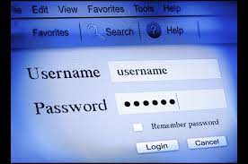

mß.Klfha wdrlaIdj i`oyd uqrmo Ndú;h
uqrmo (Password)
mß.Klh ;=< .nvd lr we;s f;dr;=re msgia;r mqoa.,hskag ,nd .; fkdyels jk mßÈ wdrlaId lr ;nd .ekSug fhdod .kakd ryia jpkh
uqrmoh wl=re(A-Z) " ixLHd(0-9) " ixfla;(@, $, %, #) wdÈfha tl;=jla úh
hq;= w;r th wju jYfhka wkq ,laIK(Characters) 08 lska iukaú; úh hq;=h'
uqrmoh Tfí ku fyda WmkaÈkh jeks wkqudk l< yels fohla fkdúh hq;=h'
úoaHq;a ;eme,a ,smskhla ,nd §u u`.ska uqrmo kej; isys le`ojd .; yelsh'
uqrmo b`.shla (Password Hint) ,nd Èh hq;=h'

Slide 10

bf,lafg%daksl wmøjH wdrlaIdldÍj neyer lruq
mß.Kl oDVdx. ish,a, u tajdfha ls%hdldÍ ld,h wjika jQ úg fyda Ndú; lrkakd th Ndú;fhka bj;a l< úg bf,lafg%daksl wmøjH f,i y`ÿkajhs'
bf,lafg%daksl wmøjH ksid je<`Èh yels frda.
f,â ^Bhï&
fud<h" wlaudj yd reêr Odjkfha úlD;s
fíßhï
fud<fha bÈóu" udxY fmaYS ÿ¾j,;d" yDo ydksh
u¾lß
iakdhq wdndO" wlaudj úkdY ùu
fnr,shï
fmKye,s ms<sld" yqiau .ekSfï wmyiq;d

Slide 11
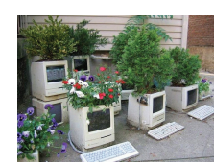
wmøjH wdrlaIdldÍj neyer l< hq;= l%u - 3R
Ndú;h wju lsÍu - Reduce
kej; m%fhdackhg .ekSu - Reuse
m%;splS%lrKh - Recycle

Slide 12
ia;+;shs …

