Slide 1
mrs.Kl j, mrsKduh

Slide 2
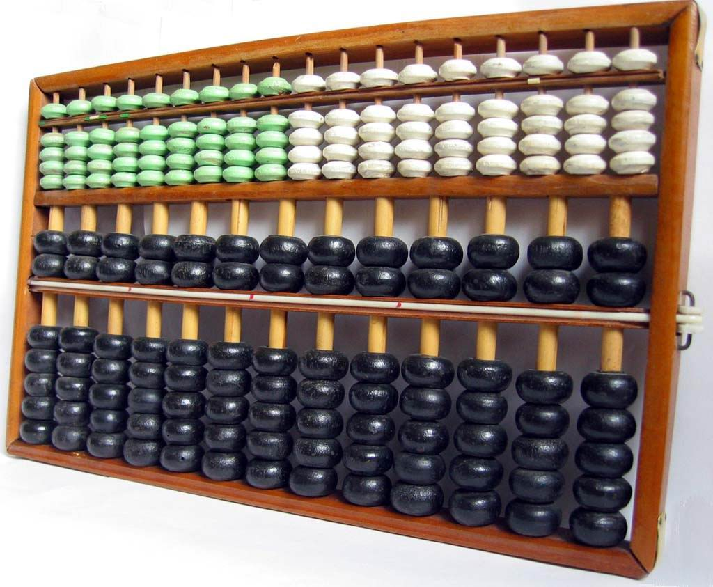
(1939-1954 )
wenlih(1939 fmr)
.Ks; l¾u myiq lr .ekSu ioyd Ndú;d l< ir, WmlrKhls .

Slide 3
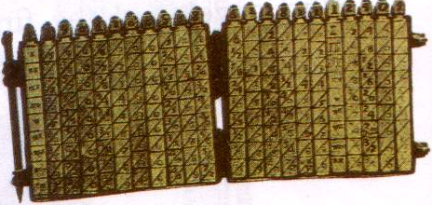
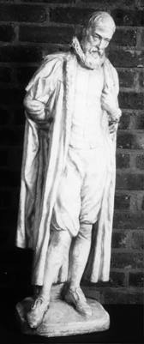
fcdaka fkamsh¾f.a we;ao< ;Sre
(1550-1617)
,>q .Kl Ndú;d lr .=K lsrSu .
fcdaka fkamsh¾

Slide 4
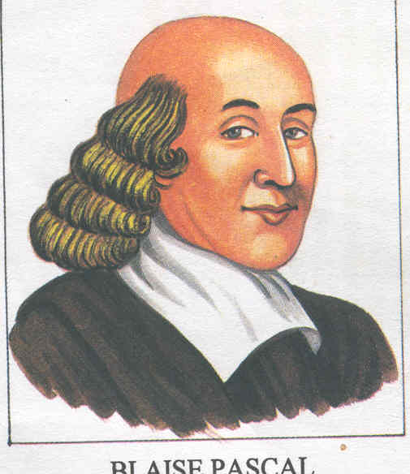
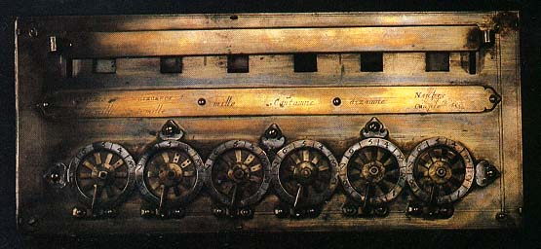
meial,af.a wdl,k hka;%h
^1642)
íf,aia meial,a
wdl,k hka;%h (pascaline)

Slide 5
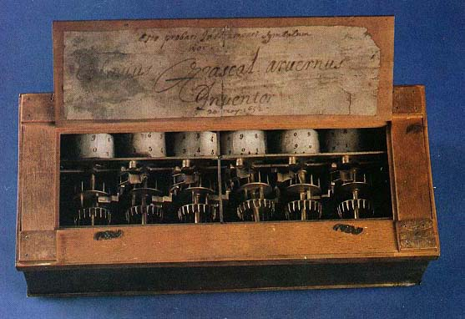
wdl,k hka;%h (pascaline)
myiqfjka tl;= lsrsu yd wvq lsrSu isÿ l< yels úh .

Slide 6

f.dâ*%Sâ ú,afy,aï
(1674)
íf,aia meial,af.a wdl,k hka;%h jeä oshqKq lrk ,oS .
fï ksid tl;= lsrsu yd wvq lsrSu Bg iudkj fnoSu yd .=K lsrsugo wjia:dj Wod úh .
f.dâ*%Sâ ú,afy,aïf.a tu hka;%h Step Reckoner f,iska yÿkajhs .

Slide 7

pd,aia nefíca
^mrs.Klfha mshd&

Slide 8
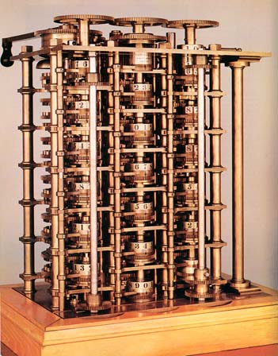
pd,aia nefícf.aa
Different Engine
(1822)
m<uq hdka;%sl mrs.Klh ioyd wjYH wdlD;sh ks¾udkh lrk ,oS .

Slide 9
fcdaIma cel=jdâf.a fros úhk hka;%h
(1801)
fros úùu myiq lr .ekSug ks¾udKh lr we; .
isÿre ldâm;a (punch card) Ndú;d lrñka fros j, rgd ueùu isÿ lr we; .

Slide 10
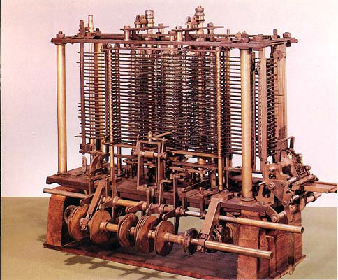
pd,aia nefícaf.a
Analytical Engine
o;a; wdodkh (input)
;ekam;a lsrSu(storing)
ilia lsrSu(processing)
m%;sodkh(output)
hk ld¾hhka isÿl< yels ùu .

Slide 11
wevd T.iagd f,dõf,aia
^1840&
f,dalfha m%:u mrs.Kl jevigyka Ys,amskshhs .
miq ld,Skj yuqod lghq;= ioyd Ndú;d l< mrs.Kl NdIdj
wevd mrs.Kl NdIdj f,i yÿkajhs .

Slide 12
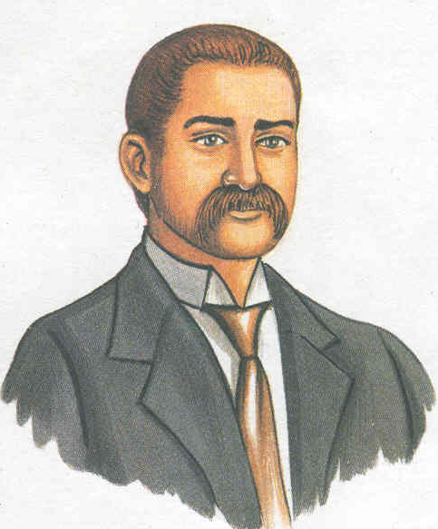
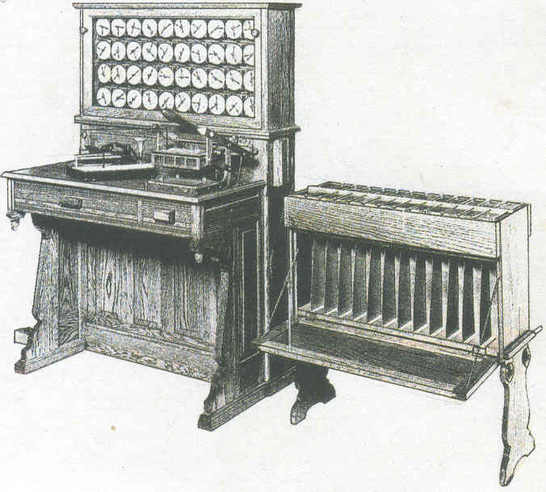
y¾uka fydf,ars;a
(1890)
Punch card machine (Tabulating Machine)

Slide 13
fcdaIma cel=jdâf.a isÿrem;a ixl,amh (punch card) Ndú;d lrñka ks¾udKh lrk ,o S.
tu.ska wefursldkq ck ix.kKh id¾:l whqrska isÿlr we;.

Slide 14
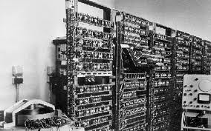
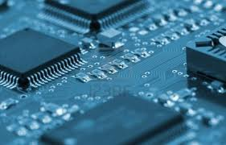
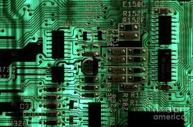
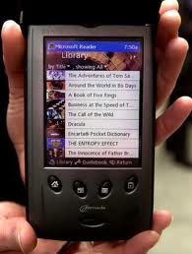
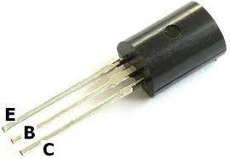
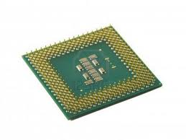
mrs.Kl mrïmrd

Slide 15
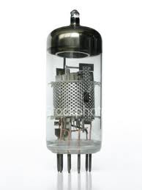
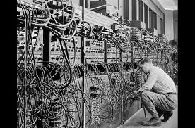
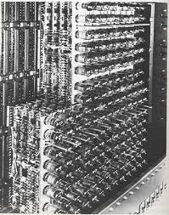
m<uq mrïmrdj (1940-1956)
rsla;l k<( vacuum tube )
Wod
UNIVAC (Universal Automatic Calculator)
IBM 704

Slide 16
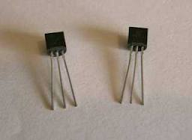

fojk mrïmrdj (1954-1959)
g%dkaisiag¾(Transistor)
g%dkaisiag¾ fidhd .ekSfï f.!rjh fn,a úoHd.drfha ú,shï fIdlaf,a , fcdaka ndäka, fjda,ag¾ n%dfÜ%ka hk whg ysñ fõ. ta ioyd fkdfn,a ;Hd.ho ysñ úh .

Slide 17

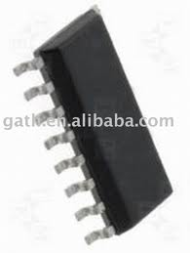
;=kajk mrïmrdj (1959-1971)
ix.Dys; $ifudaOdks; $wkql,s; mrsm: (IC)

Slide 18
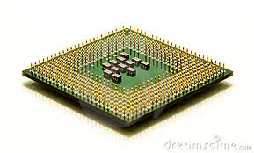
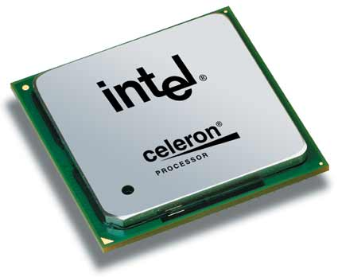
isõjk mrïmrdj (1971-1990)
laIqÞ mrsm: (microprocessor)

Slide 19
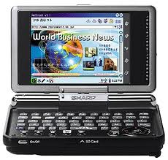
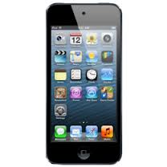
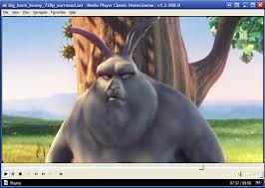
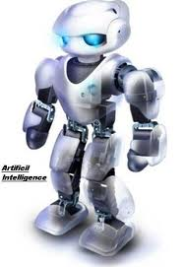
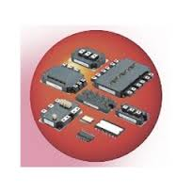
miajk mrïmrdj (1991 miq )
lD;su nqoaêh (Artificial Intelligence)

Slide 20
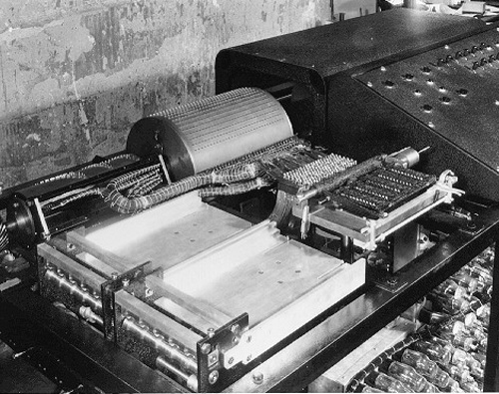
ABC mrs.Klh ^1937-1942)
uydpd¾h fcdaka úkaikaÜ wgdkdfidõ úiska w¾O jYfhka ksu lrk ,oS.
fuh úoHq;a ixLHdxl mrs.Klhla fõ .
kuq;a w¾O jYfhka ksu lr we;s ksid m%:u úoHq;a ixLHdxl mrs.Klh ùug fkdyels úh .

Slide 21
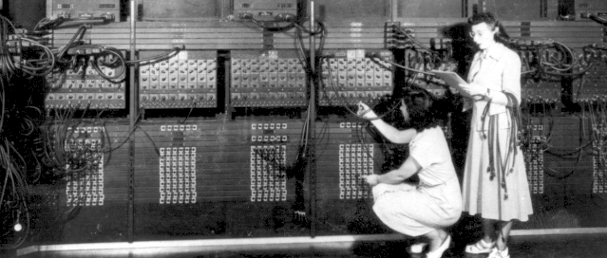
m%:u úoHq;a ixLHdxl mrs.Klh
^ENIAC)
m<uq mrïmrdfõ mrs.Klhl s .
rsla;l k< 18000 muK fhdod f.k
ks¾udKh lr we; .
tla ;;amrhla ;=, .Ks; l¾u 5000 muK isÿ l< yel .

Slide 22
m%udKfhka b;d úYd,h. fï ksid mrsyrKh wmyiqh .
úÿ,s n,h wêl f,i jeh fõ .
wêl ;dmhla uqla;fõ .
ld¾hlaIu;djh kQ;k mrs.Kl j,g idfmalaIj b;d wvqh .

Slide 23
ud¾la I hka;%h
^1944&
tl;= lsrsu wvq lsrSu fnoSu yd .=K lsrsu b;d myiqfjka isÿ lsrSug yels úh .
o;a; wdodkh - h;=re ,shkh u.sks
o;a; m%;sodkh - isÿre m;a u.sks

Slide 24
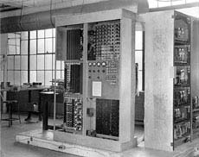
EDVAC
(1945)
fcdaka fjdka kshqudka úiska ks¾udKh lrk ,oS.
mrs.Klh ;=, o;a; ;ekam;a lr úúOdldrfhka jev lghq;= lsrSug yels úh.

Slide 25
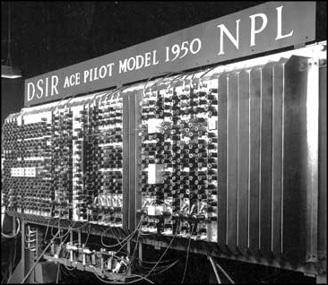
Ace
(1950)
m%:u jev igyka iys; mrs.Klhhs

Slide 26
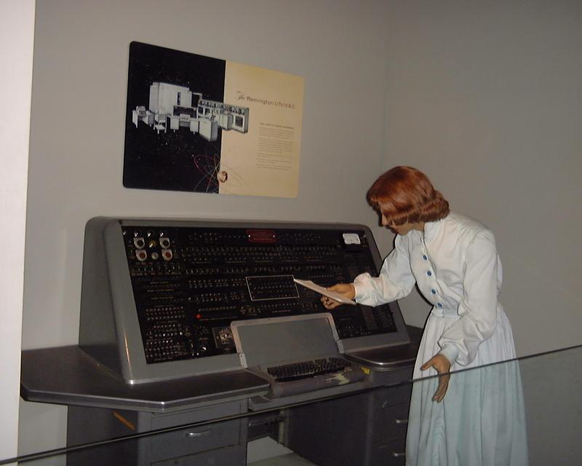
UNIVAC
(1950-1951)
frñx.agka /kaâ wdh;kh úiska ksIamdokh lrk ,oS .
uq,skau uyckhd ioyd wf,ú lrk ,o
mrs.Klhhs .
tla ;;amrhla ;=, .Ks; l¾u 10000 muK isÿ l< yel .

Slide 27
IBM 704
(1957)
fojk mrïmrdjg wh;a mrs.Klhls .
g%dkaisiag¾ iys; mrsm:hls.
m%udKfhka idfmalaIj l=vdh.
jeh jk úÿ,s n,h idfmalaIj wvqh .
tla ;;amrhla ;=, .Ks; l¾u 100,000 muK isÿ l< yel .

Slide 28
m%:u ix.Dys; mrsm:h cela la,sí úiska ks¾udKh lrk ,oS .
IBM System/360 main frame computer(1960) - Gene Amdahl m%:u ish¿ wruqKq ioyd we;s uyd mrs.Klhls .
PDP-8 – 1st Mini computer – Dec úiska ks¾udKh lrk ,oS .
m%:u uOH mrs.Klhls .
ixhqla; mrsm: j, wvx.= jQ g%dkaisiagr m%udKh wkqj tajd my; whqrska j¾. l< yel .
SSI - Small Scale Integration
MSI - Medium Scale Integration
LSI - Large Scale Integration
VLSI - Very Large Scale Integration
ULSI - Ultra Large Scale Integration

Slide 29

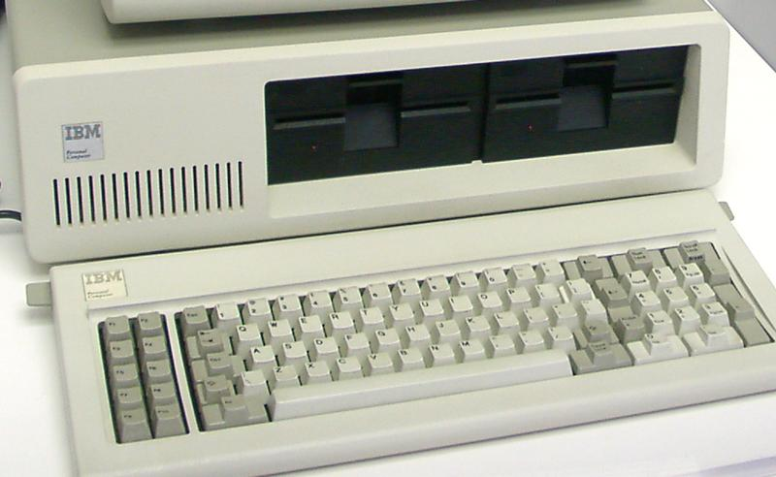
Ted Hoff – Intel (1971) – Intel 4004 laIqÞ mrsm:h ks¾udKh lrk ,oS .
H.Edward Roberts – 1975 – 1st Microcomputer m%:u laIqÞ mrs.Klhhs .
Seymour Cray -1976 – CRAY-1 Supercomputer m%:u laIqÞ mrs.Klhhs .
Stephen Wonzniak and Steven Jobs - 1977 – first Apple Microcomputer
1980 – m%:u wvqu ñ, iys; fm!oa.,sl mrs.Klh

Slide 30
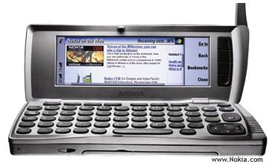
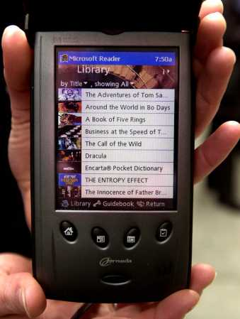
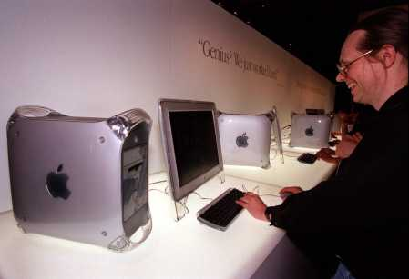
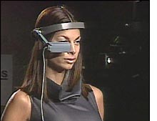
kQ;k mrs.Kl
Palm Top
PDA
Desk Top
Wearing Computer

Slide 31

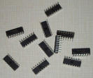
ld,h | mrsm:h | wdodk | m%;sodk | ;ekam;a lsrSu | NdIdj | uq,au mrs.Klh
1951-1959 | Vacuum Tubes rsla;l k< | Punched cards & magnetic tapes | Punched cards | Magnetic Tapes | Assembly | UNIVAC-1
1959-1965 | Transistors g%dkaisiagr | Punched cards & magnetic tapes | Punched cards | Magnetic Tapes | High level languages FORTRAN | IBM 1400
1965-1971 | Integrated Circuits ixhqla; mrsm: | Keyboards | Monitors | Magnetic disks | PASCAL | IBM System/360

Slide 32
;dlaIKfha oshqKqj;a iu. mrs.Kl j,,
fõ.h jeä úh.
m%udKfhka l=vd úh.
.nvd lsrSfï bv m%udKh jeä úh.
ksrjoH;dj jeä úh.
úYajdikSh;ajh jeä úh.
ñ, wvq úh.
jeh jk úÿ,s m%udKh wvq úh.

