Slide 1

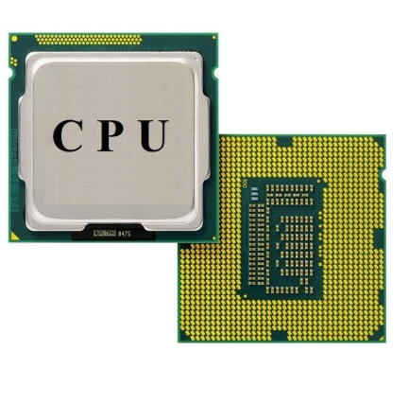

Information & Communication Technology.
Grade – 7.
Introduction Of CPU.
Krishani Umeshika Bandara.(BICT.Sp)
Reggie Ranatunga Science College

Slide 2
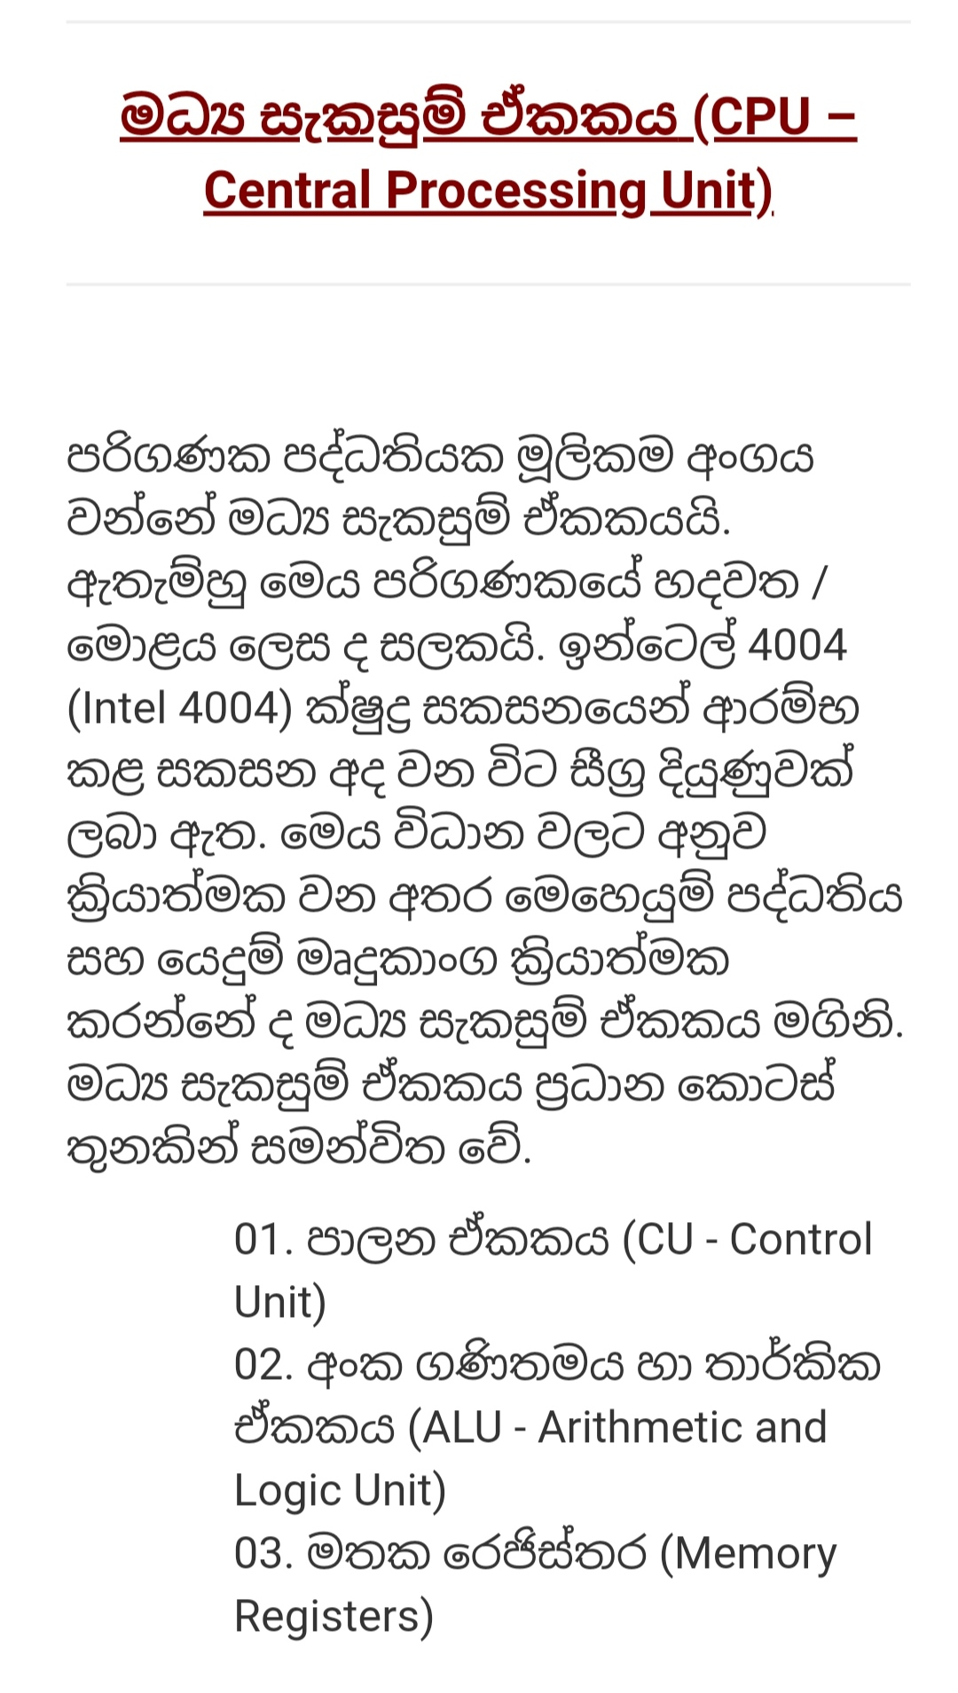

Slide 3
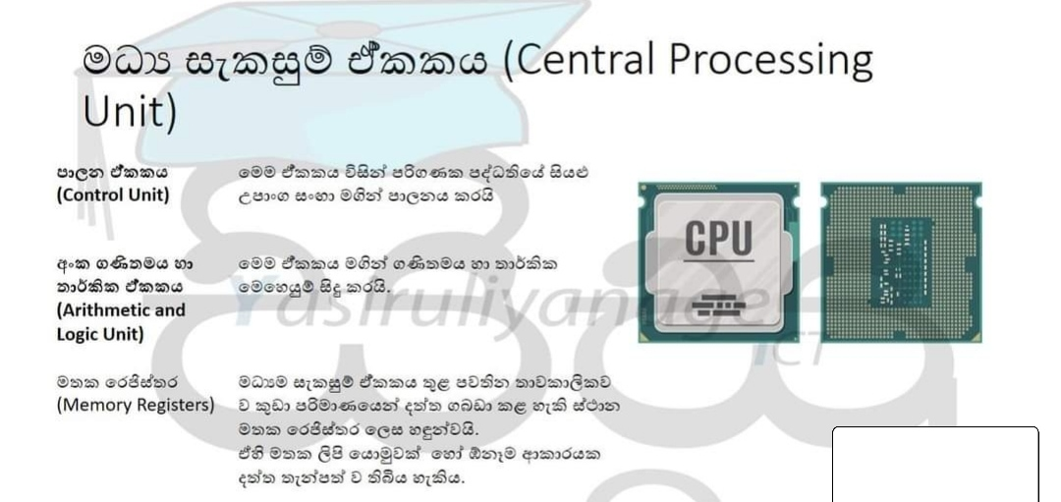

Slide 4
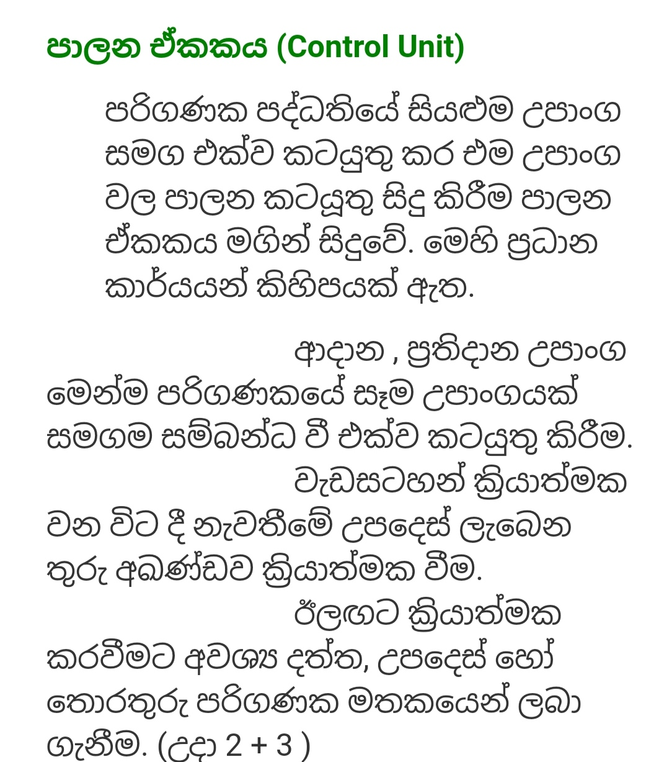

Slide 5
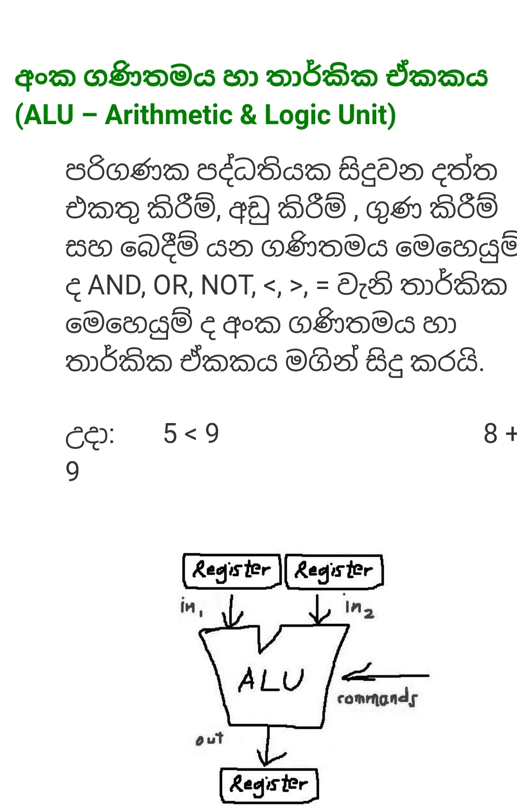

Slide 6
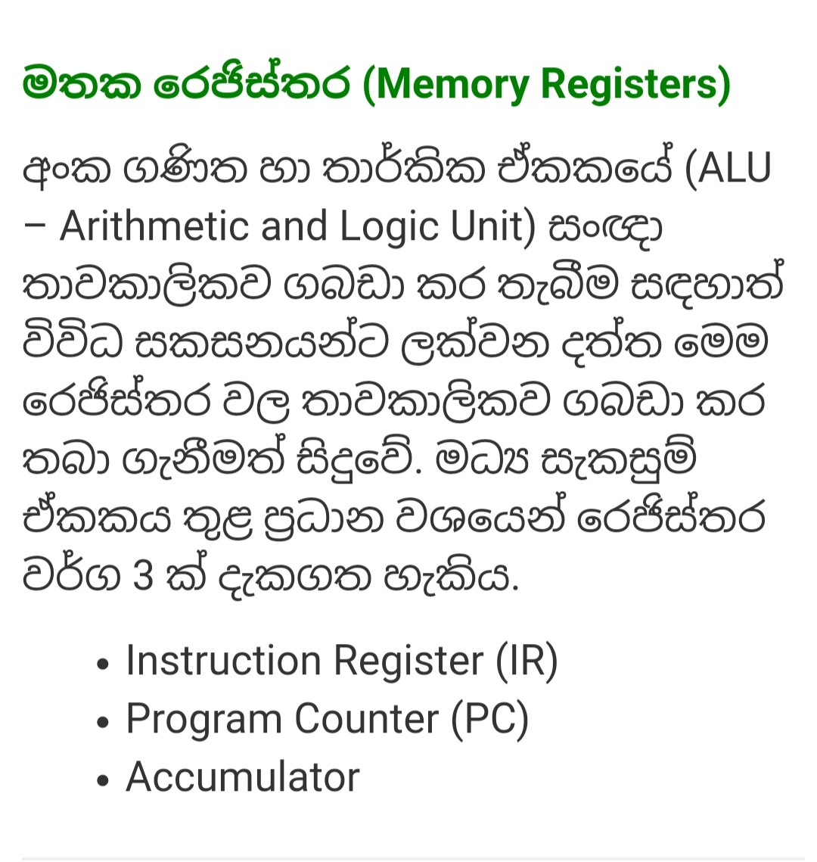

Slide 7
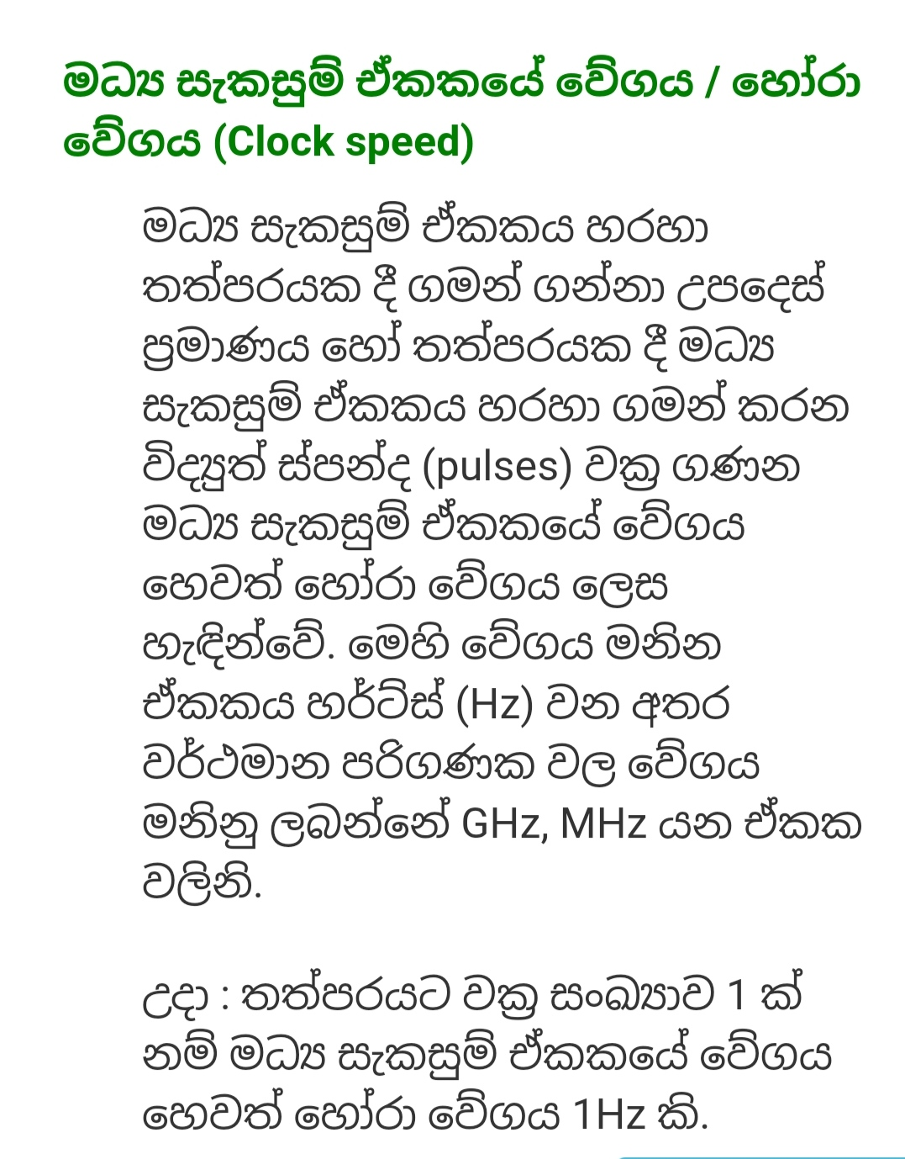

Slide 8
Thank you …..

