Slide 1
Word Classes
( Parts of Speech)
Grade -11
Minuwangoda Zonal Education Office
E- Igenum Piyasa

Slide 2
There are eight part of speech in English language. They are nouns, pronouns,
Verbs, adjectives, adverbs, prepositions, conjunctions, and interjections.
Word class | Function | Examples | Sentences
Noun | Person, animal or thing | Pencil, cat, Meena, | This is my cat. Meena is a student.
Verb | Action or state | Get, come, out, open, Like, eat | I like apple. She goes to school.
Adverbs | Describe a verb, an Adjective or adverb. | Silently, kindly, friendly | He treats kindly. Students do the activities silently.
Adjectives | Describes a noun. | Small, big, good, well, blue. | She is a good girl. He has blue eyes.

Slide 3
Pronouns | Replace a noun | I, you, he, she, it, we, they | Kamal is good person. He lives in Alawwa.
Prepositions | Links a noun to another word. | At, in, on, near, under, among, of, after | The cat is on the table. There is a hut among the trees.
Conjunctions | Join clauses or sentences | But, and, while, when, though, | He is not well but he comes to the exam.
Interjection | Short exclamation | Oh!, hi !, wow ! | Wow! What a beautiful car.

Slide 4
Word classes Activity
Fill in the blanks and write the word class in the brackets.
I think she……………………….the surprise. (……………….)
They………………………him of committing the murder. (……………..)
A suspect is a person under……………………. (……………….)
My mother has always been very………………………… (……………….)
We……………………in this neighborhood ten years ago. (………………..)
I enjoy……………………musical shows. (…………………….)
When they found him, he was………………….(………………….)
The market place is………………… with lots of venders. (………………..)
suspected,
Suspectible,
Suspecting,
suspicious,
suspicion,
Lifeless,
Lived,
Lively,
Living,
live

Slide 5
Be ………………………! It could hurt him. (…………………….)
She……………………so much about the baby. (……………………)
She is such a…………………………….person. (……………………)
Make sure to drive………………………. (…………………………)
…………………drivers will be punished. (…………………….)
Scientists………………………those reports earlier. (…………………)
You shouldn’t ……………………everything you read. (…………………)
What is your religious…………………….? (………………….)
The characters are all………………………… portrayed. (………………)
I’m ………………………myself to become a successful person. (…………)
It is very difficult to predict the weather…………………..(……………….)
Her novel is historically …………………………….(………………….)
The scientists questioned about the…………of the facts. (……………)
Caring,
Careful,
Careless,
Carefully,
cares
Belief,
Believe,
Believed,
Believing,
believable
Accuracy,
Accurately,
accurate

Slide 6
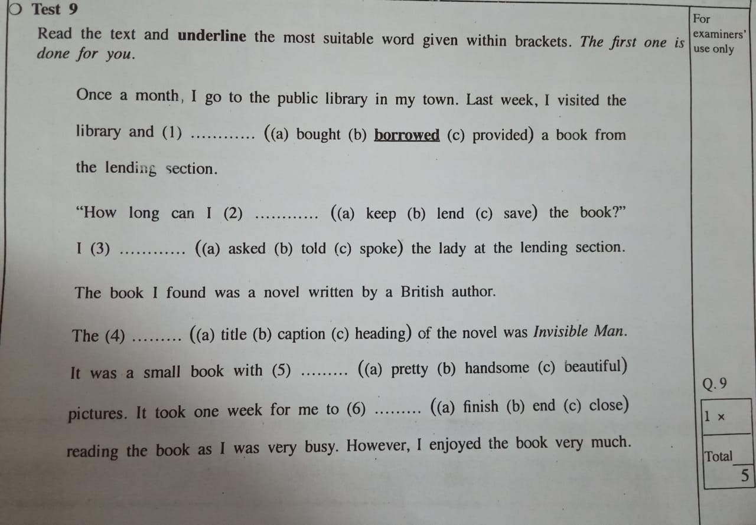
O/L 2019 Test 9

Slide 7
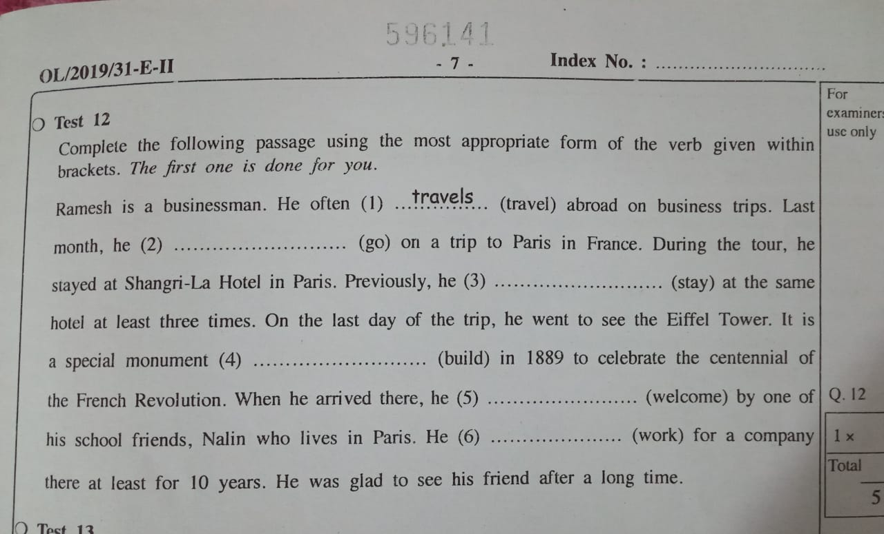
O/L 2019 Test 12

Slide 8
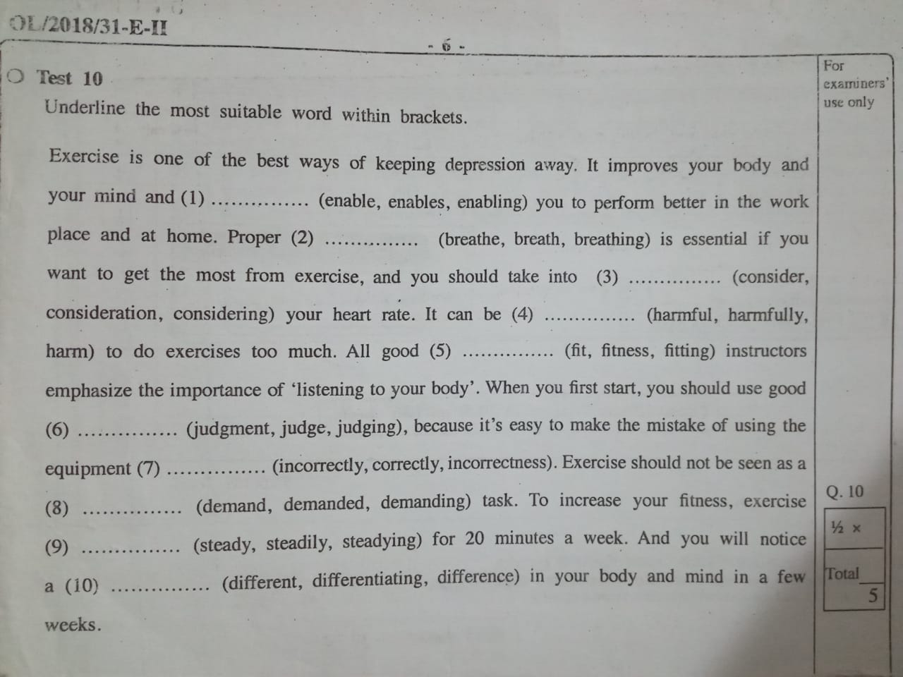
O/L 2018 Test 10

Slide 10
Thank you

Slide 11
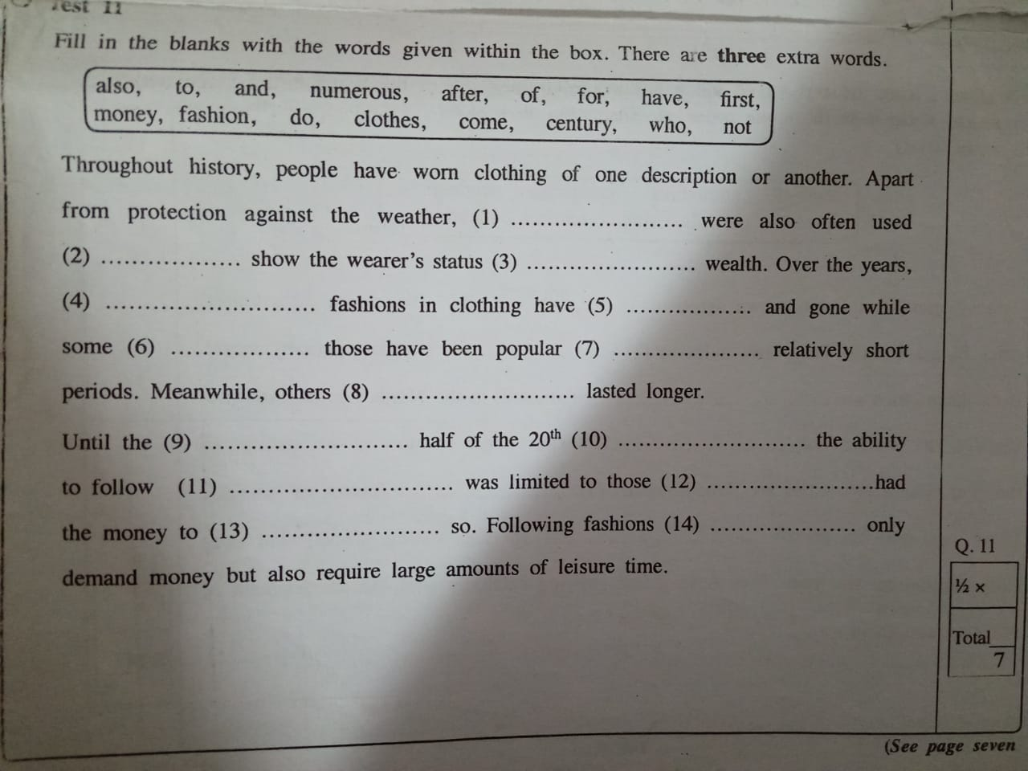
O/L 2019 Test 11

Slide 12
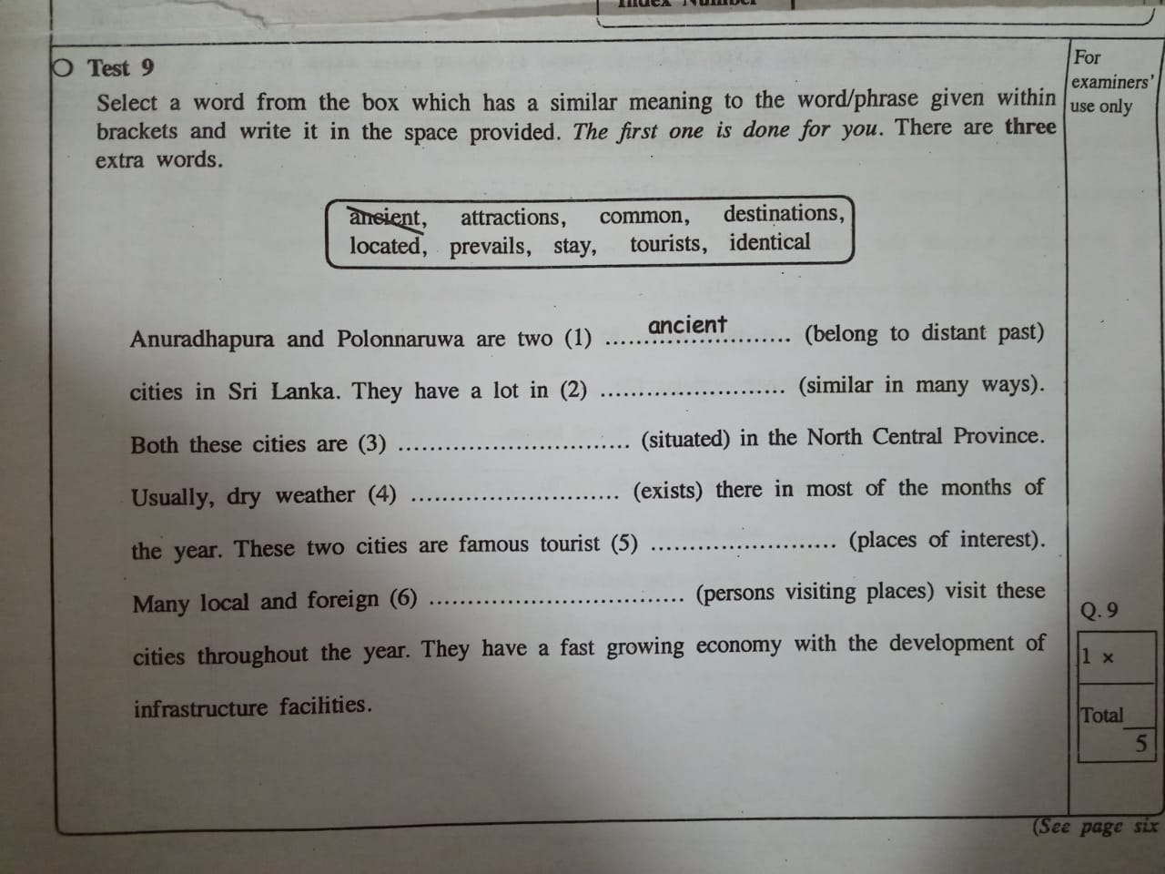
O/L 2018 Test 9

Slide 13
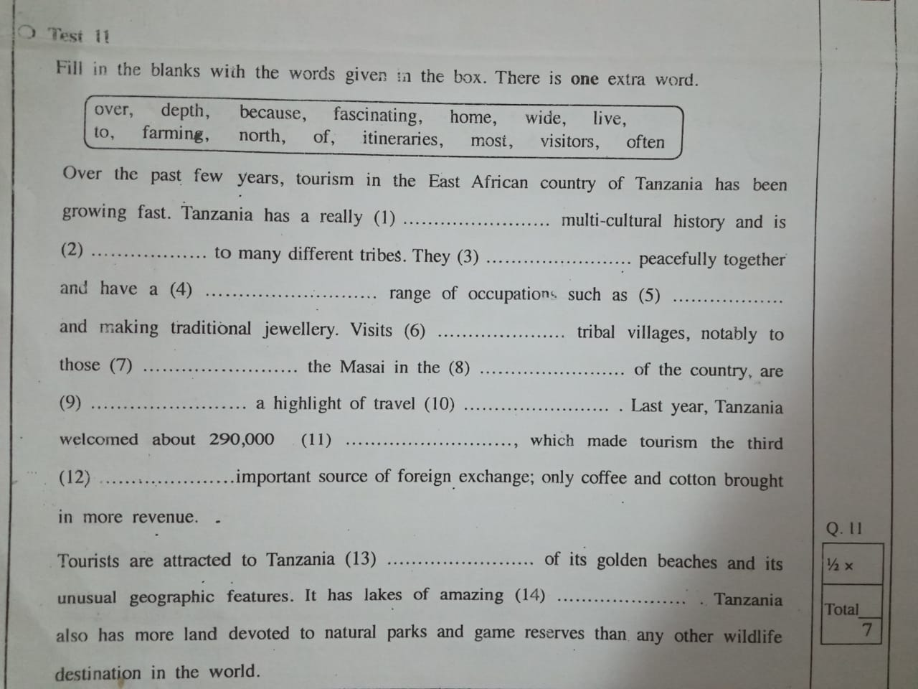
O/L 2019 Test 11

